Slide 1
Science 10
Unit 4: Ecosystems
Lesson 1: Biomes

Slide 2
Objectives
By the end of the lesson you should be able to:
Explain the difference between biotic and abiotic
Identify the biotic and abiotic features in a picture/diagram
State the biomes of Canada

Slide 3
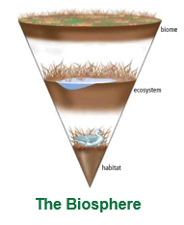
Definitions
Biosphere: area near Earth’s surface where living things can exist.

Slide 4
Definitions
Abiotic: anything that is non-living
Biotic: anything that is living

Slide 5
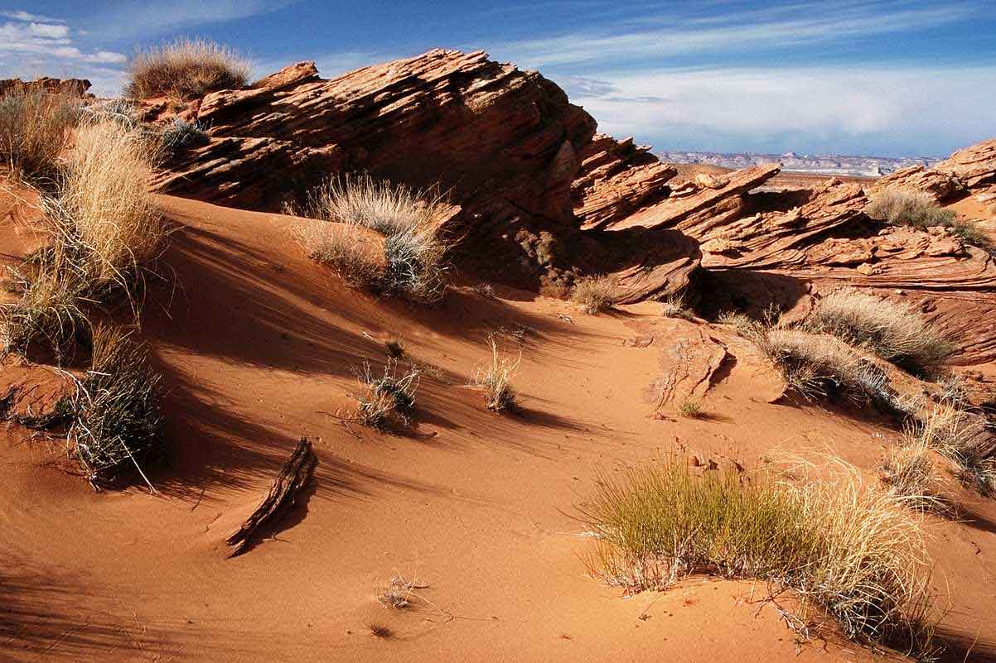
3

Slide 6
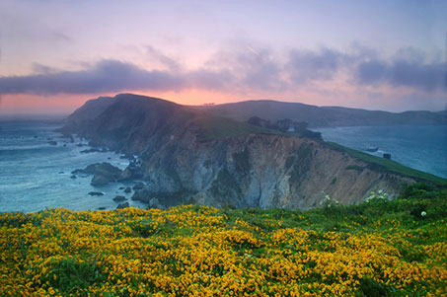
1

Slide 7
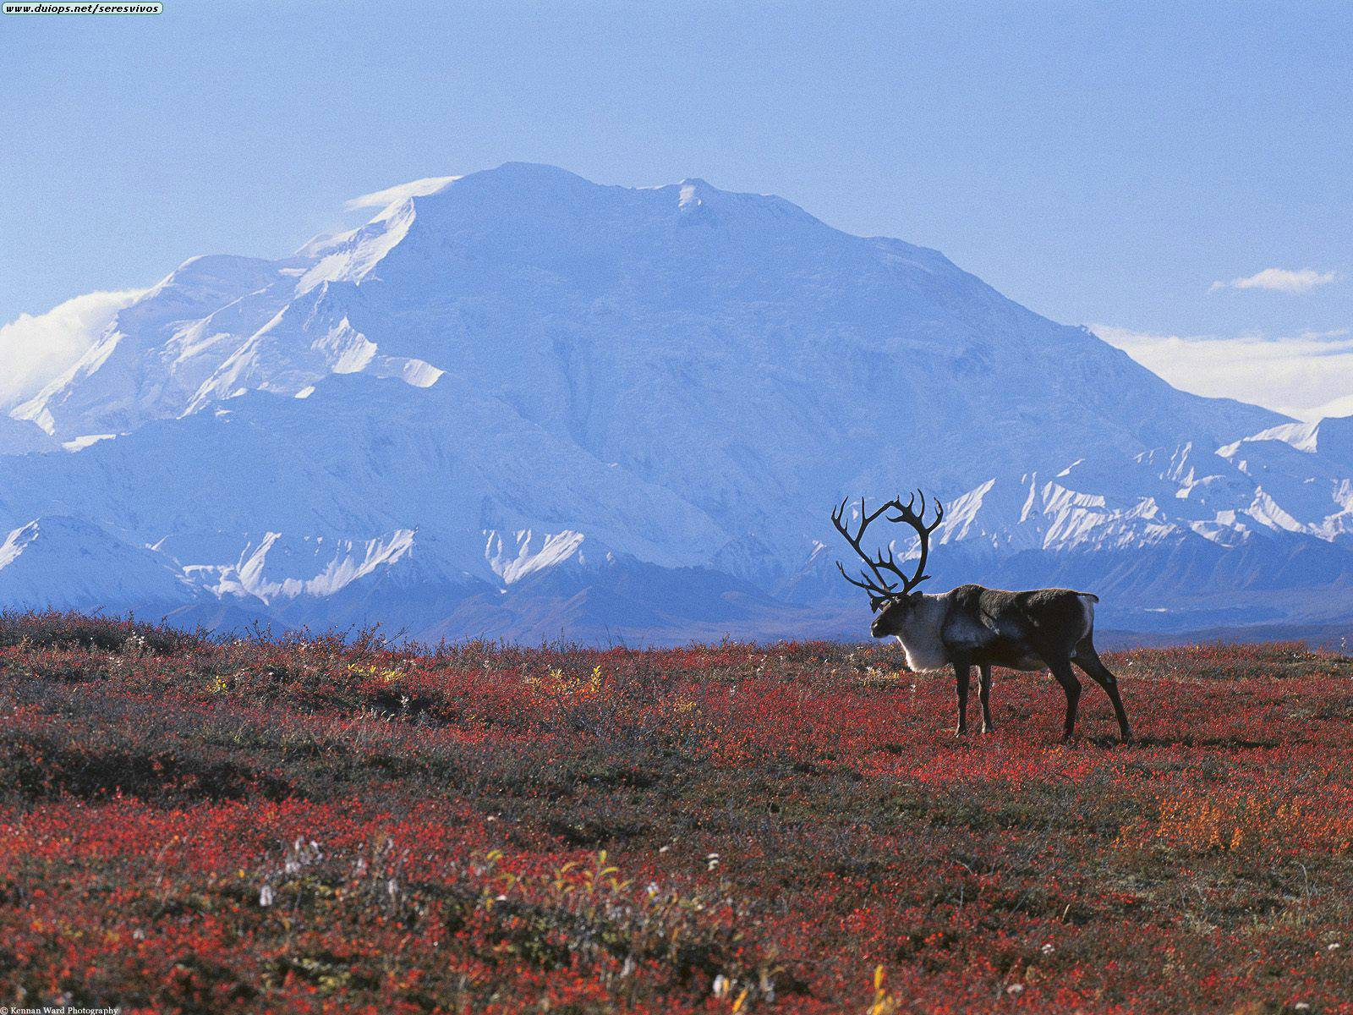
2

Slide 8
4

Slide 9
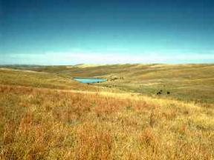
5

Slide 10
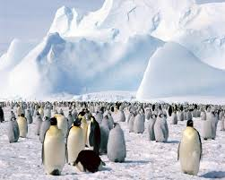
6

Slide 11
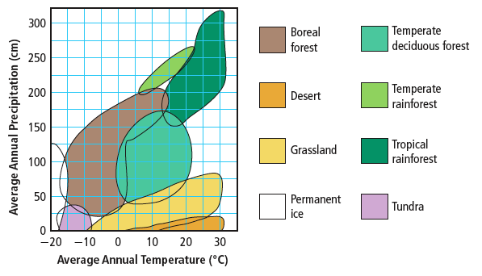
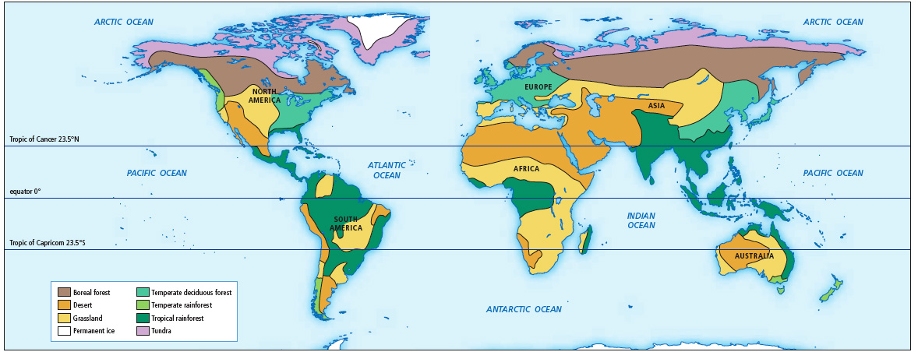
Factors That Influence the Characteristics and Distribution of Biomes
Biome: large region that has similar biotic and abiotic factors
Certain characteristics help to identify biomes.
Temperature and precipitation are two of the
most important abiotic factors.
Other factors include latitude, elevation, and
ocean currents.
Biomes of the World
See pages 10 - 13

Slide 12
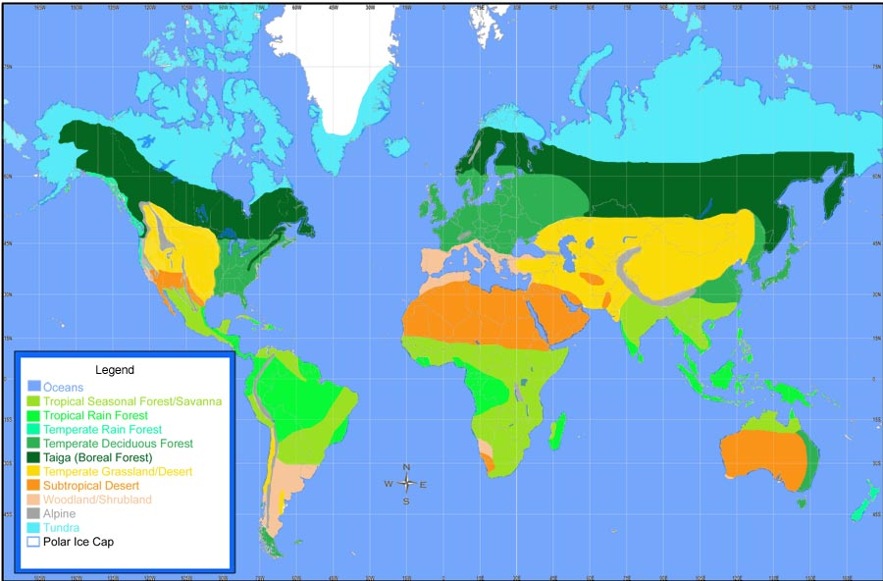
World Biomes

Slide 13
Canadian Biomes
Use your map (now beautifully coloured) to determine which biomes are located in Canada
Use the chart and the textbook (Pgs 20 - 28) to gather more data on each biome

Slide 14
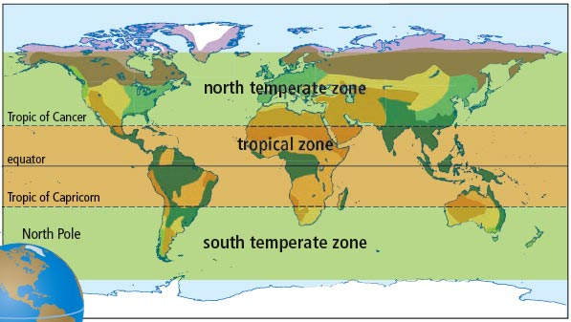
Factors That Influence the Characteristics and Distribution of Biomes (continued)
Latitude is an abiotic factor that influences biomes.
Latitude is the distance north and south from the equator.
Latitude influences both temperature and precipitation.
The tropical zone has very warm temperatures and high precipitation.
The tropical zone receives more direct sunlight than do temperate zones.
Zones of the World
See pages 14 - 15

Slide 15
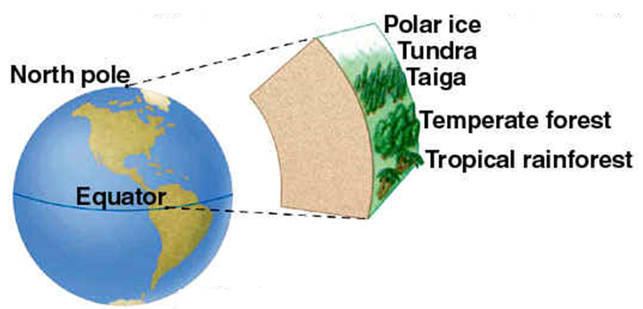

Slide 16
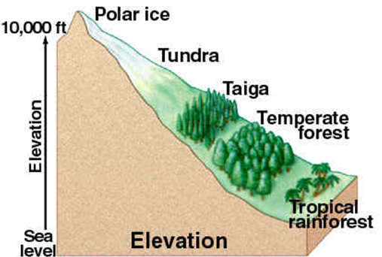
Elevation also influences biomes.
The atmosphere is thinner at higher elevations, and therefore less heat is retained.

Slide 17
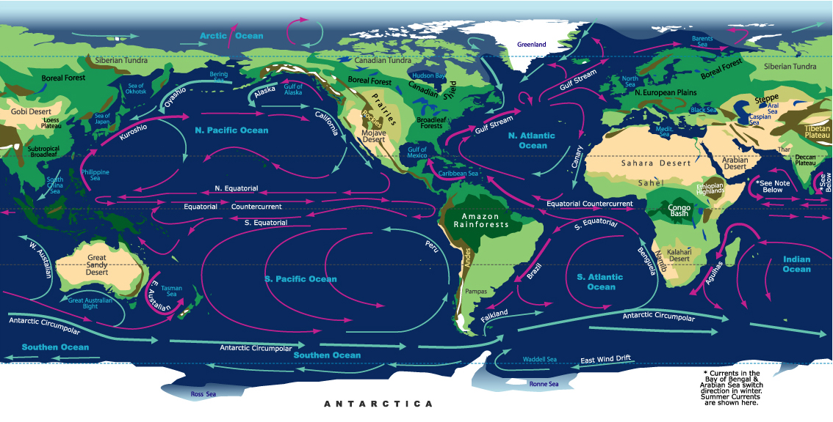
Ocean currents carry warmth and moisture to coastal areas.
Where warm currents meet land, temperate biomes are found.

Slide 18
Climatographs
Climate refers to the average pattern of weather conditions of a large region over a period of 30 years or more.
A climatograph shows the average temperature and precipitation for a location over a period of 30 years or more.
Biomes are often defined using information in climatographs.
Temperature = red lines
Precipitation = blue lines
See pages 16 - 17

Slide 20
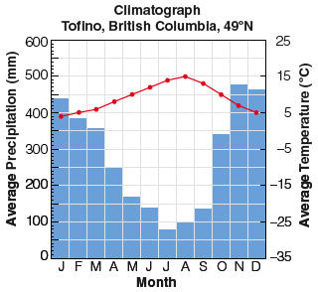
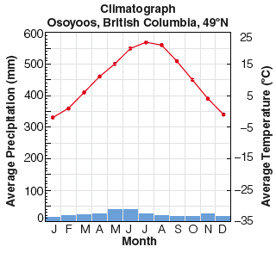

Slide 21
Your Turn!
Pg 30/31: Analyzing Climatographs
Use the graph paper when drawing your graphs
Add the climatographs to your Biomes Chart

Slide 22
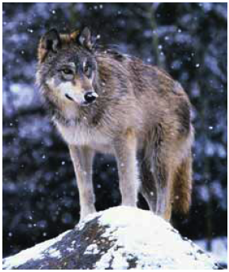
Adaptations and Biomes
Biomes are often identified with characteristic biotic factors, such as a cactus in the desert or a caribou on the tundra.
Many of these characteristic factors have special adaptations for that biome.
An adaptation is a characteristic that allows an organism to better survive and reproduce.
Structural adaptation – a physical feature that helps an organism survive
A wolf has large paws to help it run in snow.
Physiological adaptation – a physical or chemical event
inside the body of an organism that allows it to survive
A wolf maintains a constant body temperature.
Behavioural adaptation – a behaviour that helps an
organism to survive
Wolves hunt in packs to capture large prey.
See pages 18 - 19

Slide 23
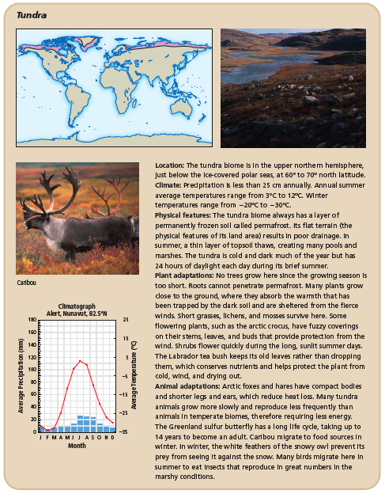
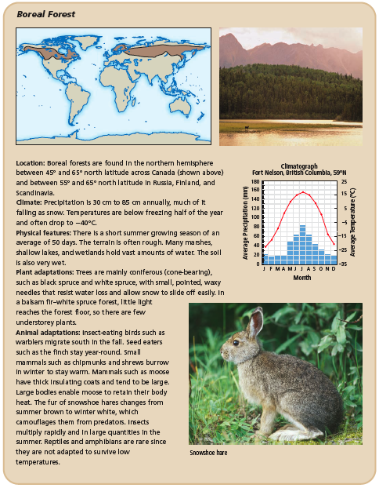
A Survey of Biomes: Tundra and Boreal Forest
See pages 20 - 21

Slide 24
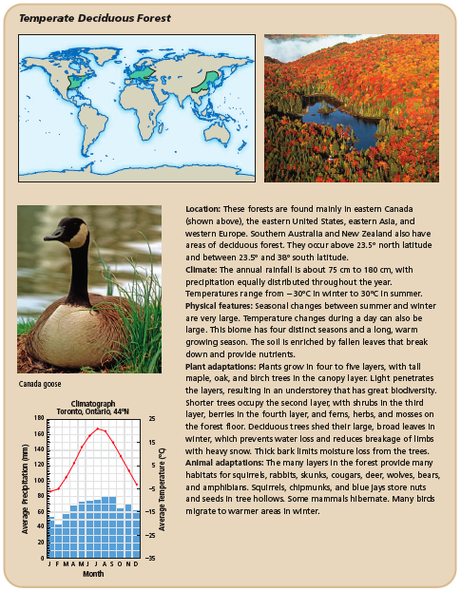
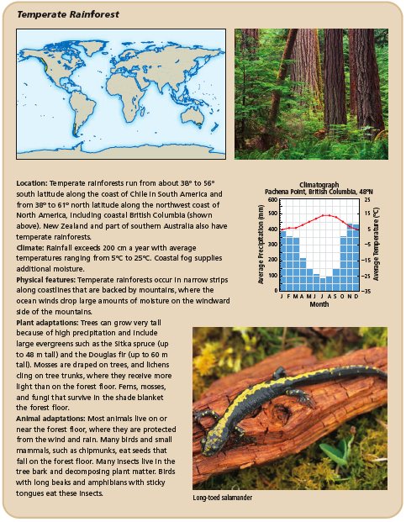
A Survey of Biomes: Temperate Deciduous Forest and Temperate Rainforest
See pages 22 - 23

Slide 25
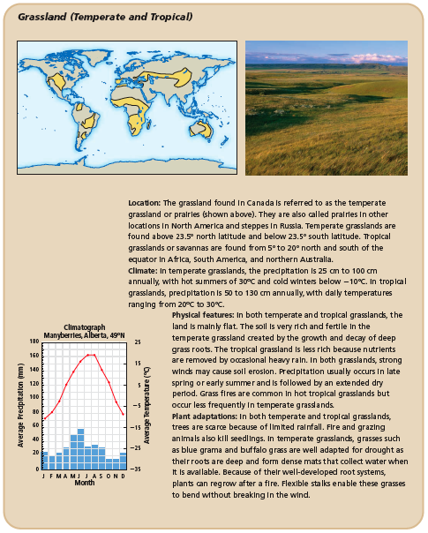
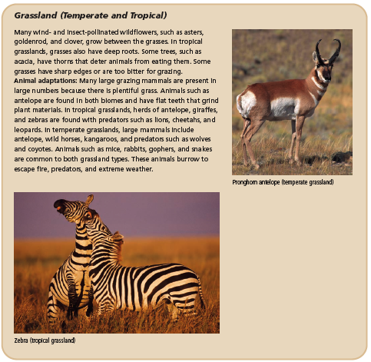
A Survey of Biomes: Grassland (Temperate and Tropical)
See pages 24 - 25

Slide 26
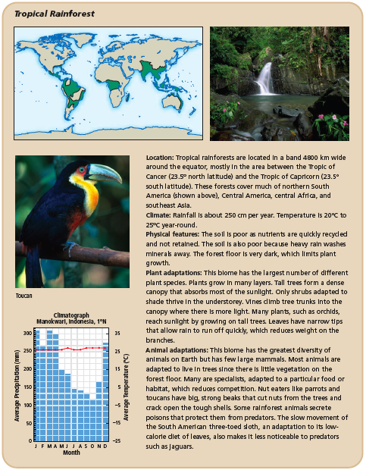
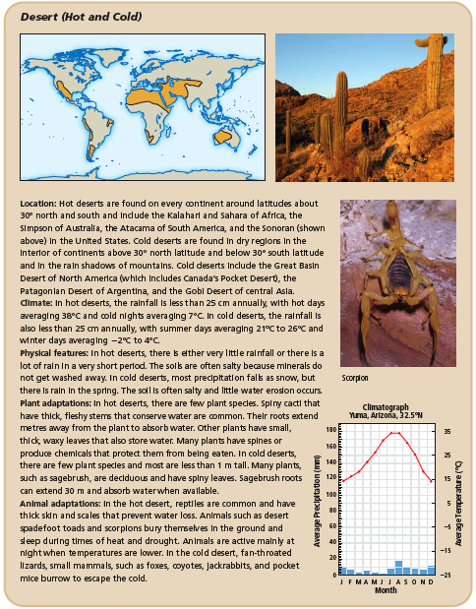
A Survey of Biomes: Tropical Rainforest and Desert (Hot and Cold)
See pages 26 - 27

Slide 27
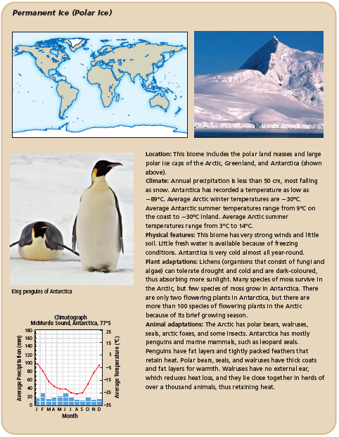
A Survey of Biomes: Permanent Ice (Polar Ice)
See page 28

