Slide 1
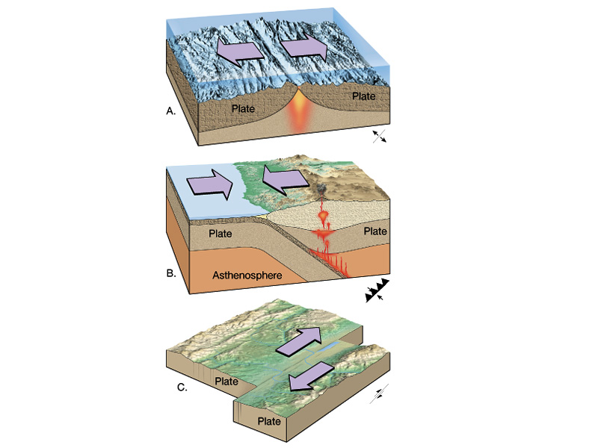
Recall Tectonic Plates Move in 3 Different Ways
  divergent boundaries = plates diverge (move apart)
  convergent boundaries = plates converge (come together)
  transform boundaries = plates slide past each other

Slide 2
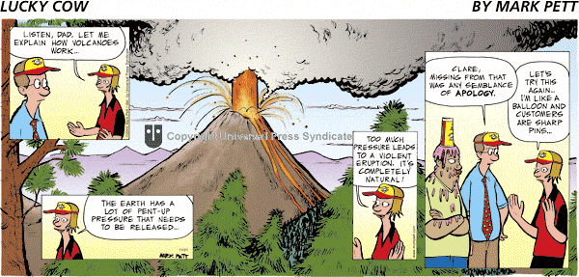
____________ and ____________
VOLCANOES

Slide 3
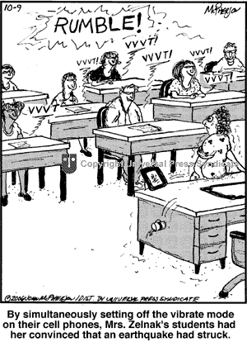
VOLCANOES and ___________
EARTHQUAKES

Slide 4
Today’s Objectives
be able to describe why volcanoes occur
be able to describe the 3 main types of volcanoes:
        composite
        shield
        rift eruptions
be able to describe why earthquakes occur
be able to describe the different types of waves
associated with earthquakes:
        P-wave
        S-wave
        L-wave

Slide 5
Volcanoes
The term volcano comes from the name of the Roman god of fire, Vulcan.
There are different types of volcanoes.
  Explosive Eruptions like we see in the movies
  Slowly flowing non-violent eruptions

Slide 6
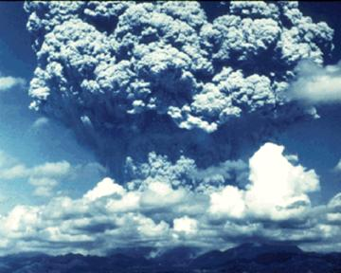
So why are some volcanoes more "explosive" than others?
  The amount of gas inside the magma is one of the things that determines how violent an eruption will be.
  The more dissolved gas, the more explosive!

Slide 7
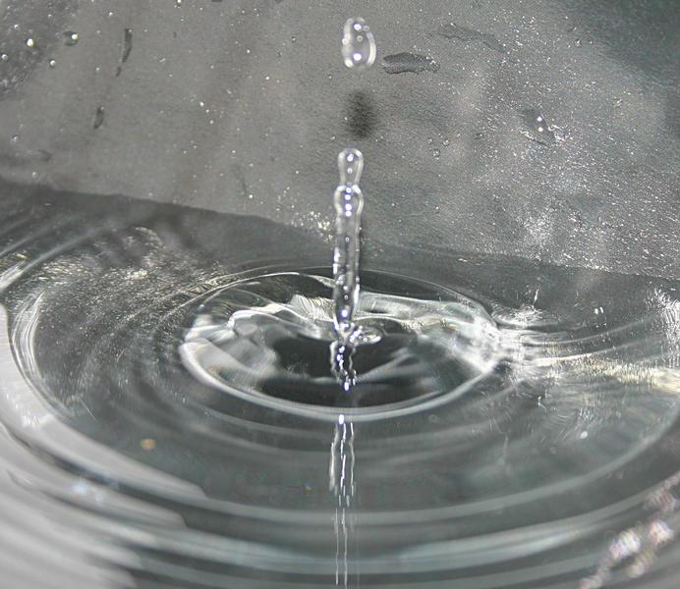
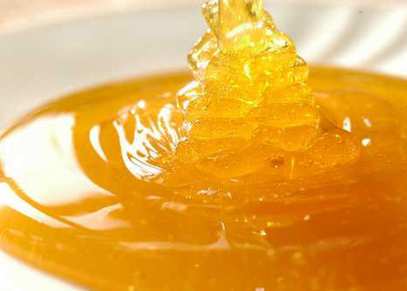
The VISCOSITY of Magma
Viscosity measures the thickness of a fluid
  Thick, sticky magma slows down the escape of gases and may also block a volcano’s main vent.
  When it finally breaks through it is VERY explosive.
HIGH (honey) LOW (water)

Slide 8
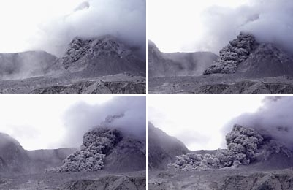
Pyroclastic Flows
Explosive volcanoes can release tiny pieces of volcanic glass, dust and gases
In super explosive eruptions glass and gases can combine to form dense, super heated cloud that travels down hill at high speeds= PYROCLASTIC FLOW

Slide 9
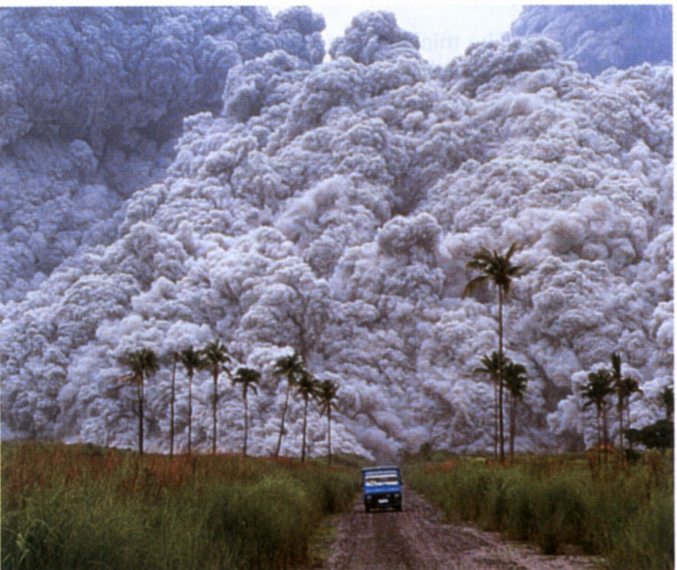
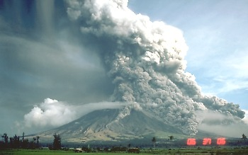

Slide 10
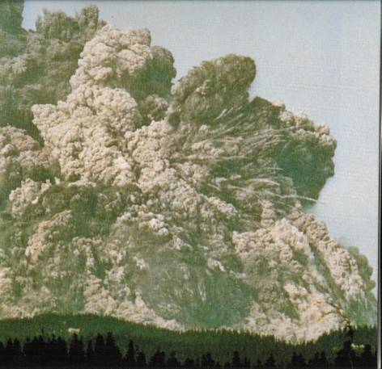
Watch what happened… in just 57 seconds…

Slide 11
The 3 types of Volcanoes
The movements of tectonic plates produces 3 distinct types of volcanoes:
  Composite Volcanoes
  Shield Volcanoes
  Rift Volcanoes

Slide 12
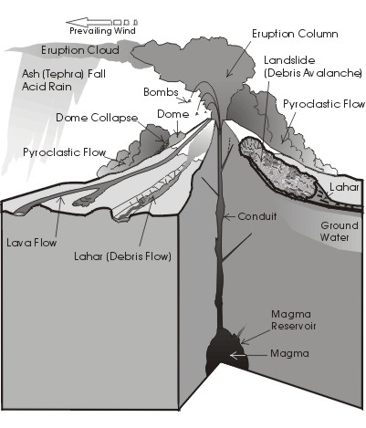
Composite Volcanoes
  cone shaped, steep
  repeated eruptions
  build up of layers of ash and lava
  thick magma traps gas then explosively erupts
  found near subduction zones
  form volcanic belts

Slide 13
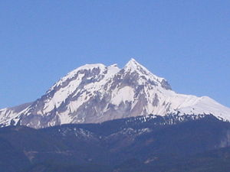
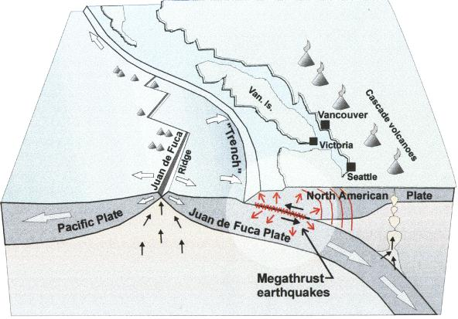
Composite Volcanoes in BC
Mount Garibaldi

Slide 14
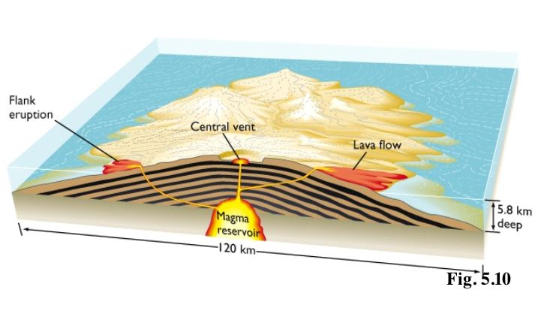
Shield Volcanoes
  largest volcanoes
  gentle slopes
  form over hotspots
  usually occurs in thinner oceanic crust but some in continental crust
  thinner magma means less explosive, tend to flow easily
  Examples: Hawaiian Island Chain

Slide 15
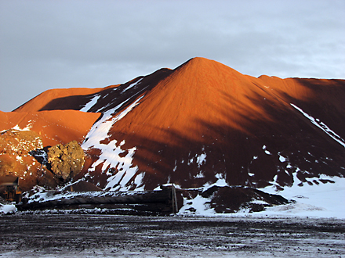
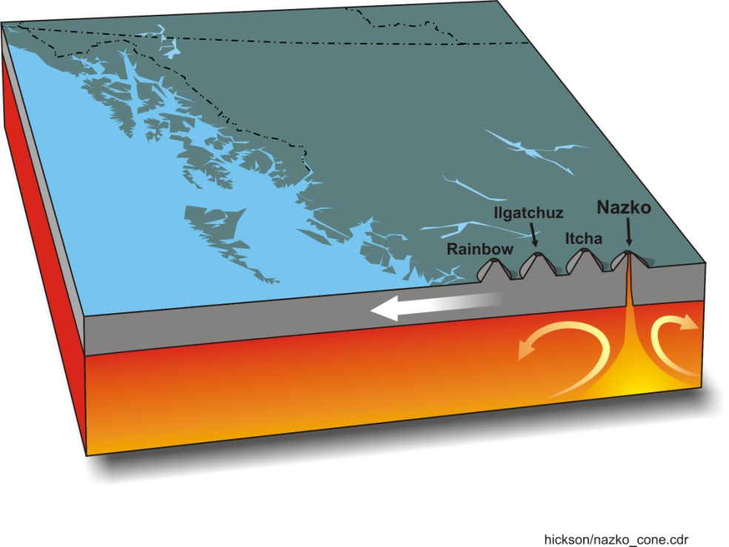
Shield Volcanoes in BC
  Nazko Cone in Anahim Belt

Slide 16
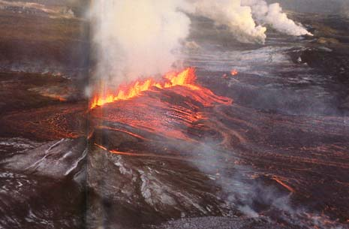
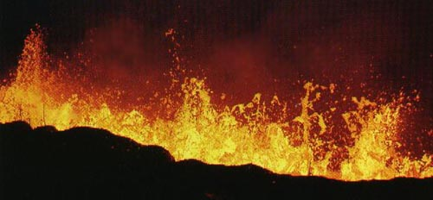
Rift Eruptions
  occur when magma erupts through long cracks in the lithosphere
  not particularly violent
  create lava curtains
  release enormous amounts of lava

Slide 17
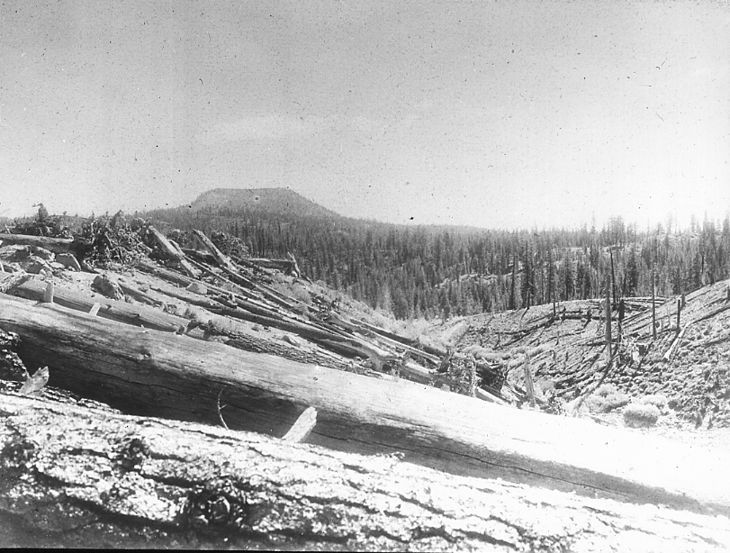
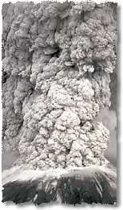
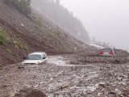
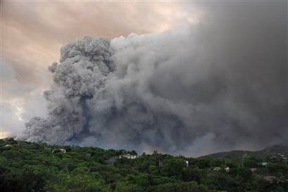
Why can Volcanoes be so Dangerous???
:
  Super-heated toxic gases and
  debris (pyroclastic flows)
  Volcanic earthquakes
  Landslides and lahars (mudflows)
  Ash clouds or deposits

Slide 18
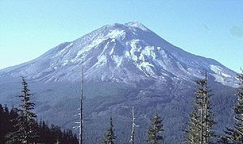
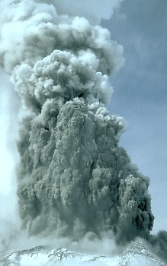
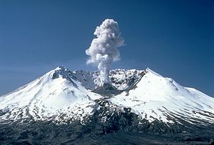
Mount St. Helens
Eruption Spring 1980
Mt. St. Helens the day before its eruption in 1980.
May 19, 1982
62 people died in thick ash and choking smoke and many more were injured. 400 square kilometres of forests were flattened and disappeared, and roads and bridges were demolished. Total economic losses were estimated at US $1.2 billion (in 1980 values).

Slide 19
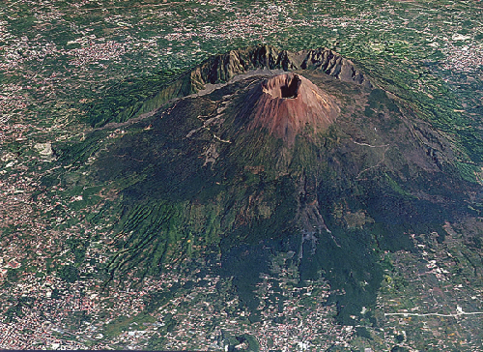
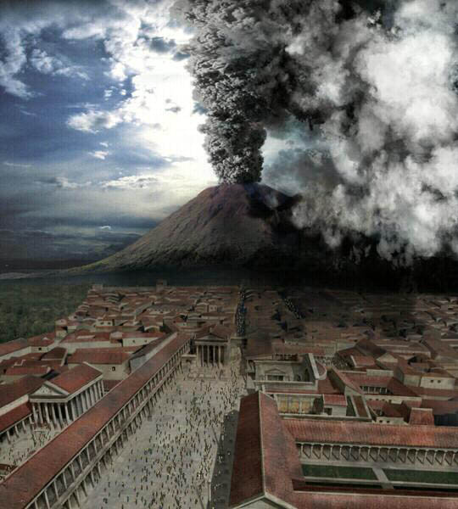
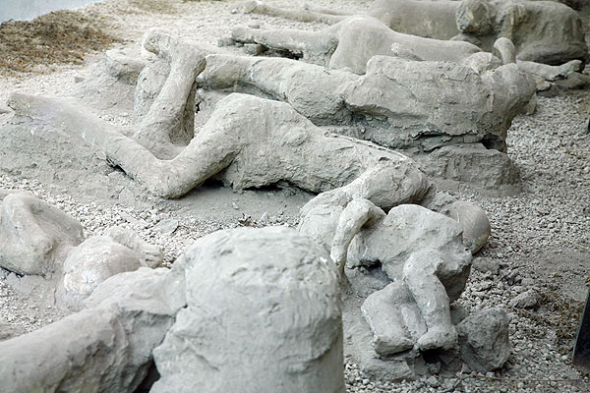
Mount Vesuvius

Slide 20
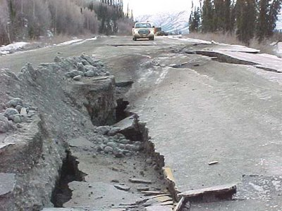
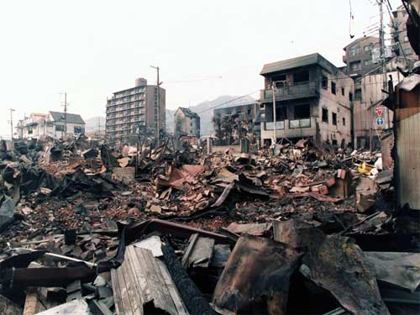
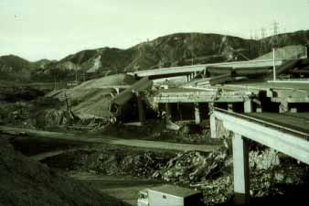
Earthquakes!

Slide 21
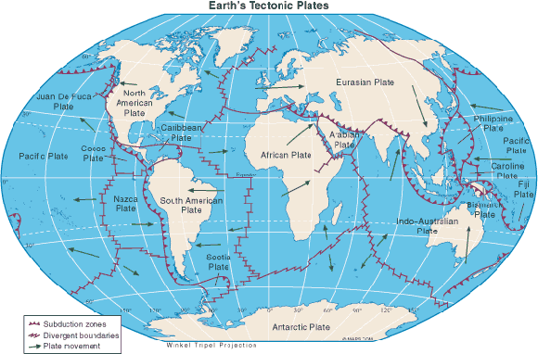
Where do Earthquakes occur?
  95 % occur at plate boundaries where t he edges of the plates are in contact with each other

Slide 22
What is an Earthquake?
An earthquake is the shaking of the ground caused by a sudden release of built-up energy at or under Earth's surface.
They occur at all 3 types of Boundaries
Most of the time friction prevents plates from moving but eventually the strain becomes greater than the friction and the plates slip.
The movement occurs along a FAULT

Slide 23
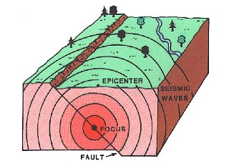
Describing an Earthquake
FOCUS= The point at which the FIRST movement occurs ( where the rocks first move)
  This usually occurs many kilometers below
EPICENTER= The point at Earth’s surface directly above the earthquake’s focus

Slide 24
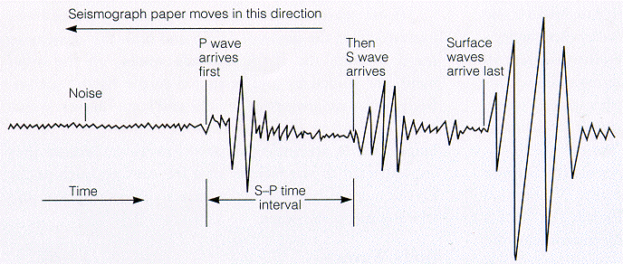
Seismology
When an Earthquake occurs it releases its vibration energy in the form of WAVES
  These are called: SEISMIC WAVES
Seismology is the study of Earthquakes and the energy waves that it releases
There are 3 different types of waves:
  P-Waves
  S-Waves
  L-Waves

Slide 25
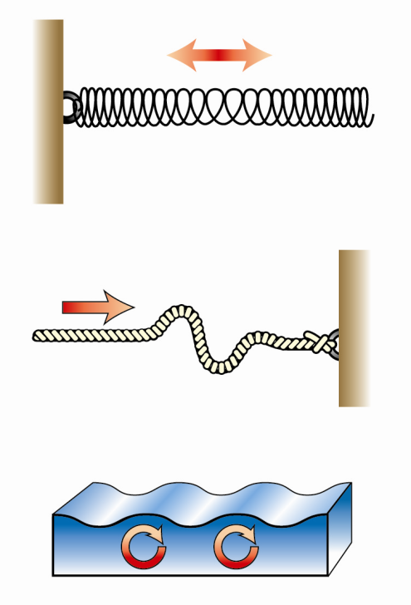


Seismic Wave | Description | Ground Motion
P - Wave | Primary wave (1st to arrive) travels through solid, liquid and gas
S - Wave | Secondary wave (2nd to arrive) travels through solid only greater damage
L - Wave | Love wave (last to arrive) roll along Earth’s surface

Slide 26
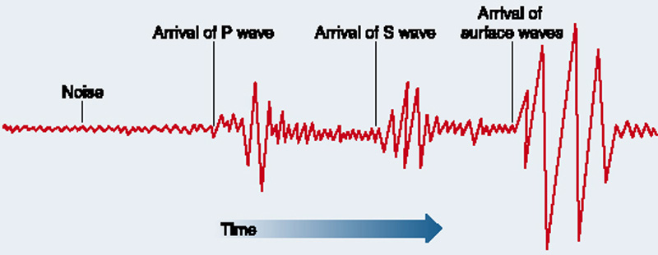
Types of Waves on a Seismograph
It is the time between the arrival of the P-waves and the S-waves that tells scientists how far they are from the epicenter of the earthquake!

Slide 27
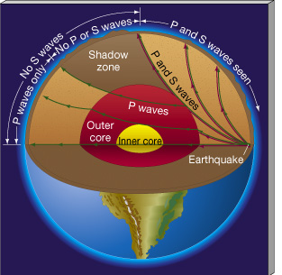
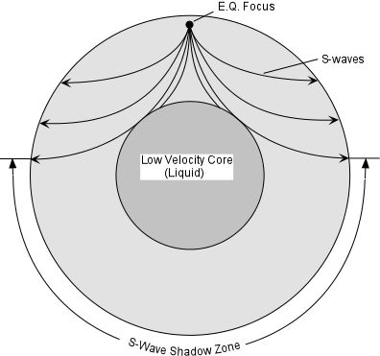
Only P-waves can travel through the Earth’s liquid outer core!
S-Waves cannot penetrate the Outer Liquid Core

Slide 28
How do we Measure Earthquakes???
  seismometer = measures ground movement
  seismogram = a recording of the ground movement
  magnitude = size of earthquake based on size of waves

Slide 29
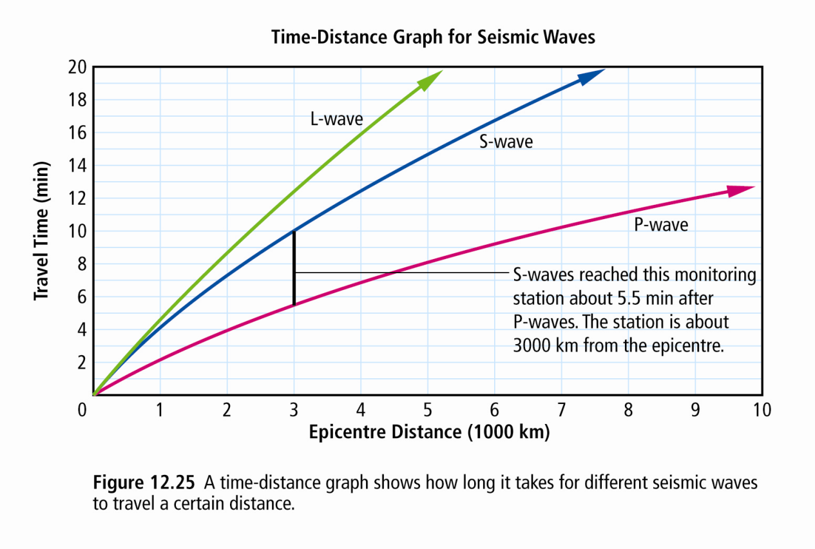
S-P Interval
  The amount of time between when the P-waves first arrive and the S-waves arrive
  Allows us to calculate how far away an epicentre is

Slide 30
The Richter Scale
The Richter Scale measures the amount of ground movement using a seismometer
  each whole number increase on the magnitude scale = a 10x increase in the size of waves
  magnitude 2.0 = can feel at the epicentre
  magnitude 6.0 = damages weaker buildings
  magnitude 8.0 = severe damage to buildings
  difference in wave size from magnitude 2.0 to 6.0 =
  10 x 10 x 10 x 10 = 10 000x bigger (like the pH scale)

Slide 31
Did you Know….???
The largest recorded earthquake in Canada was a magnitude 8.1 that struck off the shore of the Queen Charlotte Islands on October 22, 1949!
The largest recorded earthquake in the world was a magnitude 9.5 in Chile on May 22, 1960!

Slide 32
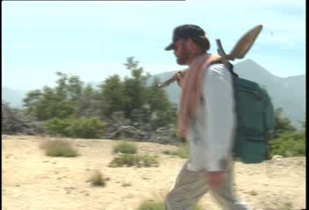
Identifying and Measuring Seismic Waves

