Slide 1
_______ of the Earth
Layers
ayers

Slide 2
Today’s Objectives
Describe and Explain how and why tectonic plates can move
Be able to label and describe Earth’s 6 layers
Inner core
Outer Core
Lower Mantle
Upper Mantle
Asthenosphere
Crust ( including the tectonic plates)
Be able to define and describe the term lithosphere

Slide 3
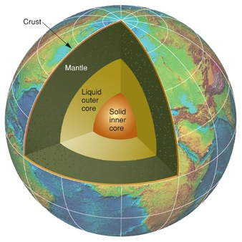
Regions of the Earth
The Earth is made up of three major regions, like an apple:
Crust (like the skin)
Mantle (like the flesh of the fruit)
Core (like the core and seeds)

Slide 4
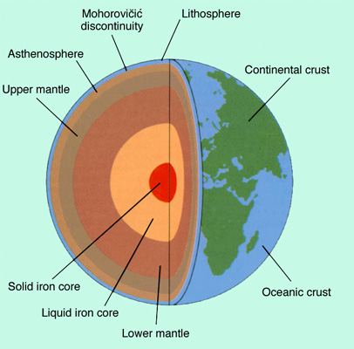
Earth can be further divided into more layers!
Layers of the earth rap:
http://www.educationalrap.com/59/layers-of-the-earth.html

Slide 5
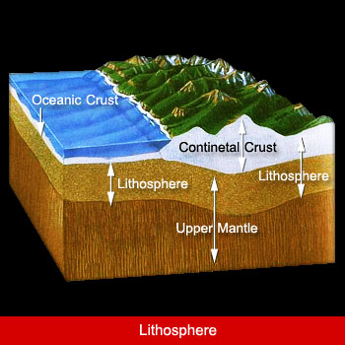
A.The Crust (0-35km)
The crust is the top, solid surface layer of the Earth
Oceanic crust is the crust under oceans, and continental crust is the crust under the continents
It can range from 10km thick (oceanic) to 70km thick (continental)

Slide 6
Plate Tectonics
Below the crust is where we find the plates.
The crust is attached to the plates
The crust and the plates are both solid, rigid and hard
We can give the Crust and the Plates a special name= LITHOSPHERE
LITHOS= STONE

Slide 7
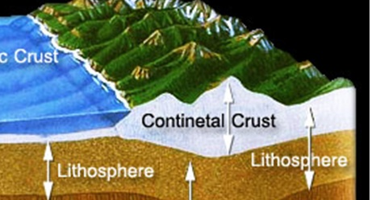
LITHOSPHERE
CRUST
PLATES

Slide 8
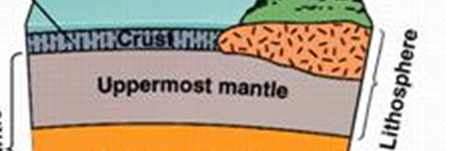
Tectonic PLATES
Tectonic plates make up the upper most region of a layer called the MANTLE.
PLATES

Slide 9
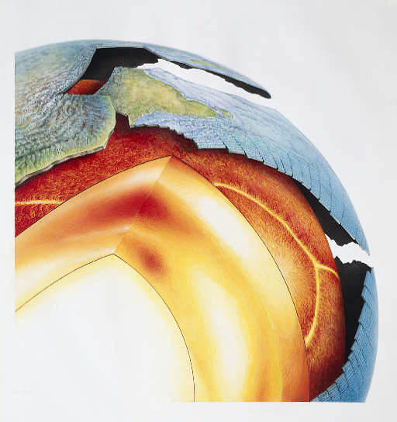
The Mantle: (35-2900km)
The mantle is the semi-solid layer directly below the crust.
It contains 70% of the Earth’s volume
It can itself be broken into 2 distinct parts:
The Upper Mantle (35- 670 km)
The Transition Zone (300- 700km)
The Lower Mantle (670- 2900km)

Slide 10
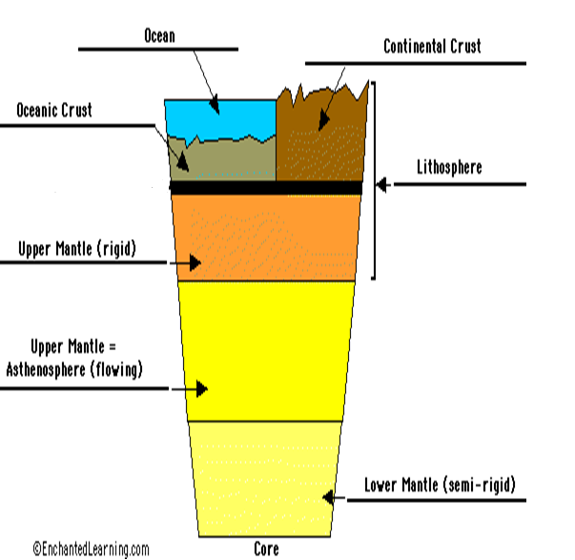

Slide 11
The Upper Mantle:(35 - 670 km)
660 km think
Separated into 2 layers
The layer closest to the crust is the solid rock layer that makes up the tectonic plates
The layer below the plates is the semi-solid molten layer called the ASTHENOSPHERE

Slide 12
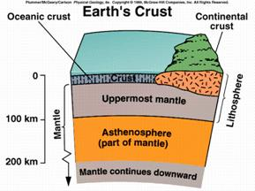

Slide 13
The Asthenosphere
The molten rock layer, with a consistency of thick toothpaste
Convection Currents in the asthenosphere are partly responsible for the movement of the plates
The majority of the heat comes from radioactive decay within the mantle
ASTHENES= WEAK

Slide 14
The Lower Mantle: (670 - 2900km)
The lower mantle comprises nearly 50 percent of the Earth’s Interior
It is made of solid rock, but has plumes of liquid magma that convect heat from the core to the plates.

Slide 15
The Outer Core: (2900 - 5200km)
The outer core consists of flowing, liquid metal. This movement creates the Earth’s main magnetic field.
It is composed of Iron and Nickel
It is somewhere between 3700-5500 K

Slide 16
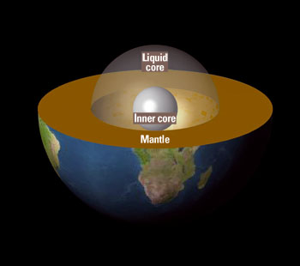
The Inner Core: (5200-6371km)
While most of the core is liquid, the inner core is solid Nickel and Iron
The inner core is 6000 K!!!

Slide 17
Summary:

Slide 18
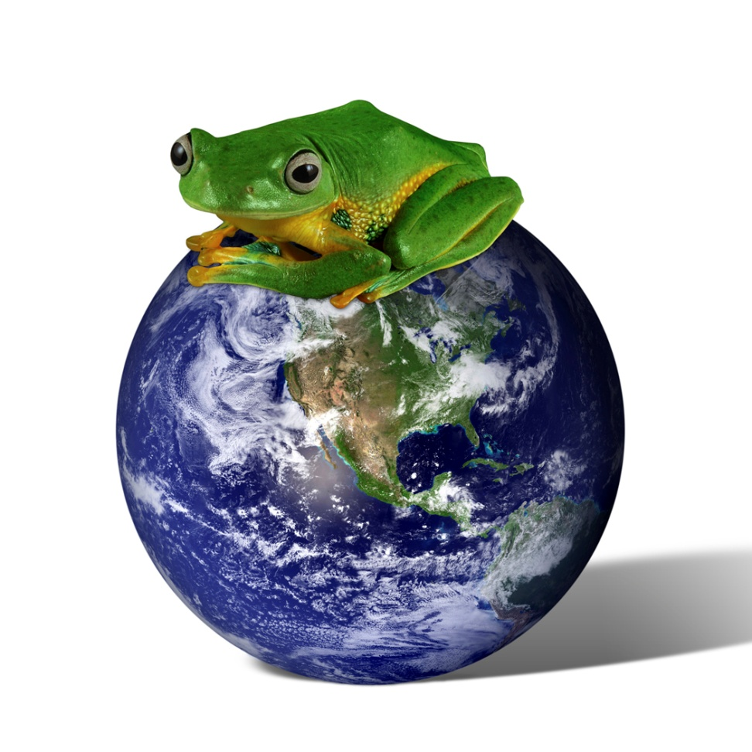
Layers of the Earth

Slide 19
Earth’s Layers and Plate Movement
We care about the layers of the Earth because they can help us to explain how the Earth’s tectonic plates move
Convection Currents in the mantle (asthenosphere), thermal heat from the core, gravity and plate interaction all affect plate movement!

