Slide 1
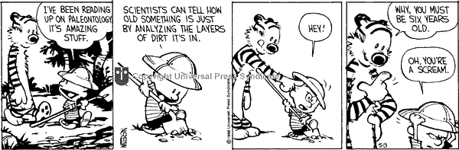
Layers of the Earth & Plate Boundaries

Slide 2
Today’s Objectives
Describe and Explain how and why tectonic plates can move
Be able to label and describe Earth’s layers
Define and Describe the 2 different types of tectonic plates
  Oceanic
  Continental
Describe and Define the 3 ways in which plates can interact:
  Diverging (pulling apart)
  Converging (coming together)
  Transforming (sliding past)
Define and Describe
  Ridge Push
  Slab Pull

Slide 3
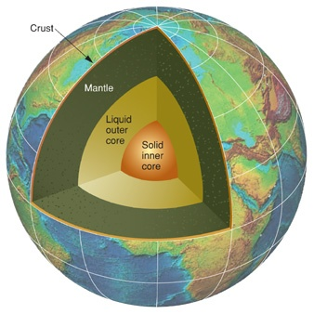
Regions of the Earth
The Earth is made up of three major regions, like an apple:
  Crust (like the skin)
  Mantle (like the flesh of the fruit)
  Core (like the core and seeds)

Slide 4
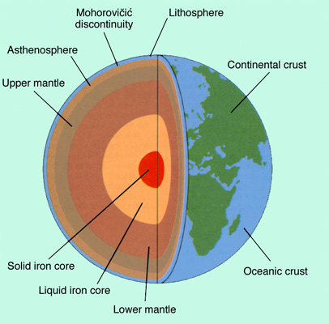
Earth can be further divided into more layers!
Layers of the earth rap:
http://www.educationalrap.com/59/layers-of-the-earth.html

Slide 5
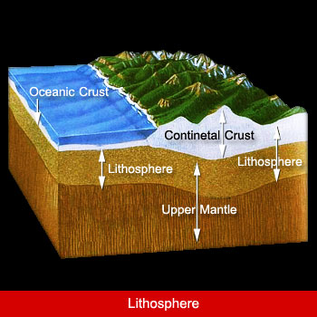
A.The Crust
The crust is the top, solid surface layer of the Earth
Oceanic crust is the crust under oceans, and continental crust is the crust under the continents
It can range from 10km thick (oceanic) to 70km thick (continental)

Slide 6
Plate Tectonics
Below the crust is where we find the plates.
The crust is attached to the plates
The crust and the plates are both solid, rigid and hard
We can give the Crust and the Plates a special name= LITHOSPHERE
  LITHOS= STONE

Slide 7
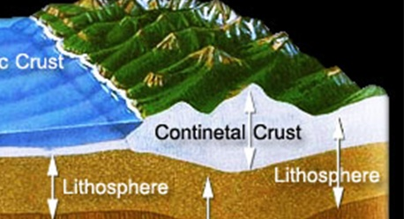
LITHOSPHERE
CRUST
PLATES

Slide 8
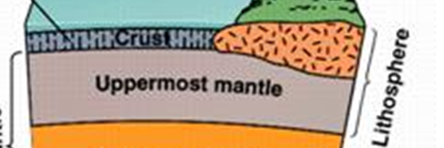
Tectonic PLATES
Tectonic plates make up the upper most region of a layer called the MANTLE.
PLATES

Slide 9
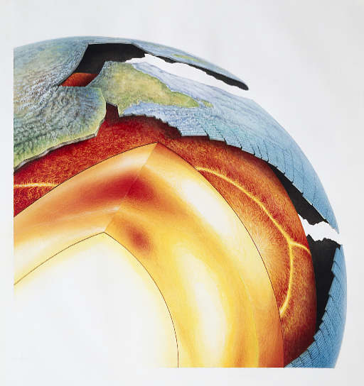
The Mantle:
The mantle is the semi-solid layer directly below the crust.
It contains 70% of the Earth’s volume
It can itself be broken into 2 distinct parts:
  The Upper Mantle
  (35- 670 km)
    The Transition Zone
    (300- 700km)
  The Lower Mantle
  (670- 2900km)

Slide 10
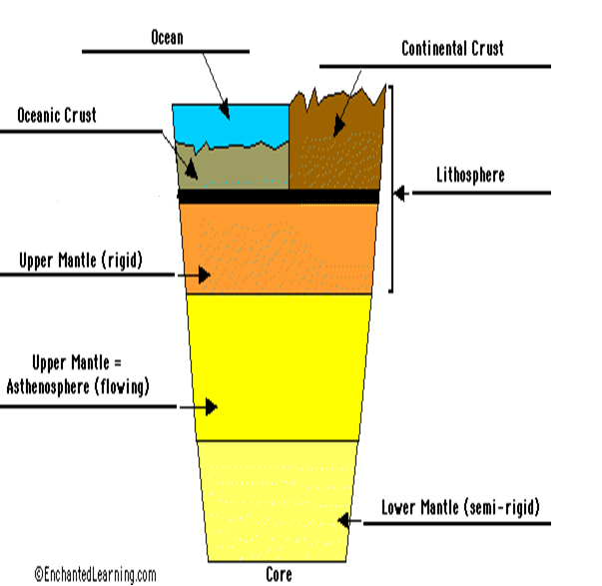

Slide 11
The Upper Mantle:
Separated into 2 layers
  The layer closest to the crust is the solid rock layer that makes up the tectonic plates
  The layer below the plates is the semi-solid molten layer called the ASTHENOSPHERE

Slide 12
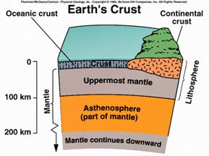

Slide 13
The Asthenosphere
The molten rock layer, with a consistency of thick toothpaste
Convection Currents in the asthenosphere are partly responsible for the movement of the plates
The majority of the heat comes from radioactive decay within the mantle
ASTHENES= WEAK

Slide 14
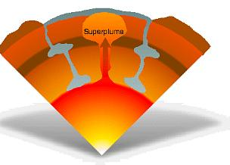
The Lower Mantle:
The lower mantle comprises nearly 50 percent of the Earth’s Interior
It is made of solid rock, but has plumes of liquid magma that convect heat from the core to the plates.

Slide 15
The Outer Core:
The outer core consists of flowing, liquid metal. This movement creates the Earth’s main magnetic field.
It is composed of iron and nickel
It is somewhere between 3400-5500 ºC

Slide 16
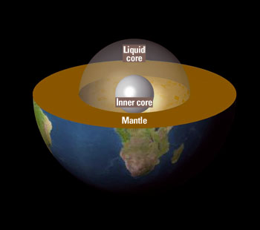
The Inner Core:
(5200-6371km)
While most of the core is liquid, the inner core is solid Nickel and Iron
The inner core is 6000 ºC!!!

Slide 17
Summary:

Slide 18
Earth’s Layers and Plate Movement
We care about the layers of the Earth because they can help us to explain how the Earth’s tectonic plates move
Convection Currents in the mantle (asthenosphere), thermal heat from the core, gravity and plate interaction all affect plate movement at plate boundaries!

Slide 19
Plate Boundaries
Two Types of Plates
Oceanic Plate:
  More Dense and Heavy
  Made of a specific rock called BASALT
Continental Plate:
  Less dense and Light
  Made of a specific rock called GRANITE
  When these two types of plates interact, the Oceanic Plate ALWAYS sinks below the continental plate.

Slide 20
Plate Boundaries…
At the edges of the plates is where all the action occurs
When Plates move – there are only 3 choices they have…
1) Separate from each other (DIVERGE)
2) Crash directly into each other and one goes under the other (CONVERGE)
3)Slide past/along one another (TRANSFORM)

Slide 21
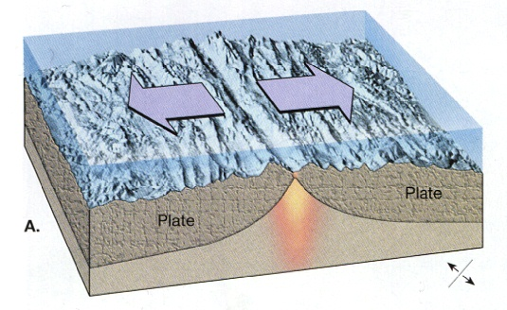
3 Types of Plate Boundaries
#1-DIVERGENT boundaries
2 plates move away from each other opening a gap called a spreading center
There are 2 types:
  Oceanic-Oceanic
  Continental- Continental

Slide 22
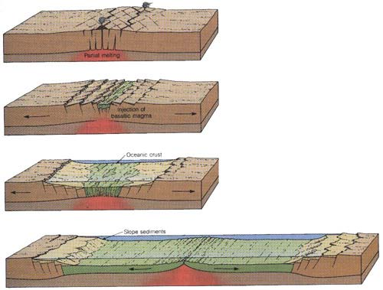
As molten rock comes up through the crack created by the diverging plates, it pushes the old crust aside causing it to buckle.
This process is called RIDGE PUSH

Slide 23
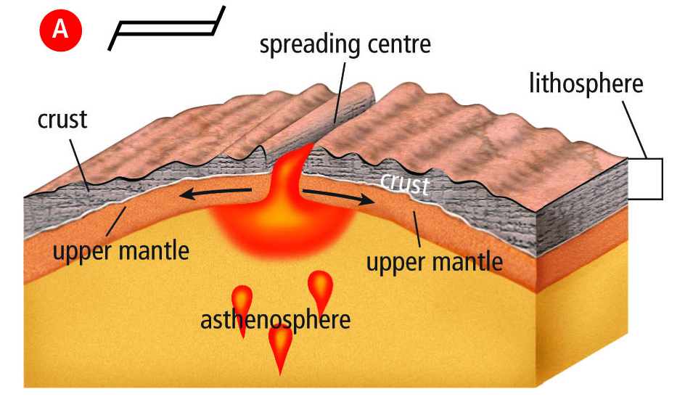
Divergent…
This is the symbol on a map for divergent boundaries
RIDGE PUSH

Slide 24
Divergent plates over water…
When tectonic plates diverge, pull part, over water, the spreading center is called a SPREADING RIDGEor OCEANIC RIDGE.
Because the magma rising up through the crack and pushes the old crust aside, new sea floor is created
This is called SEA FLOOR SPREADING

Slide 25
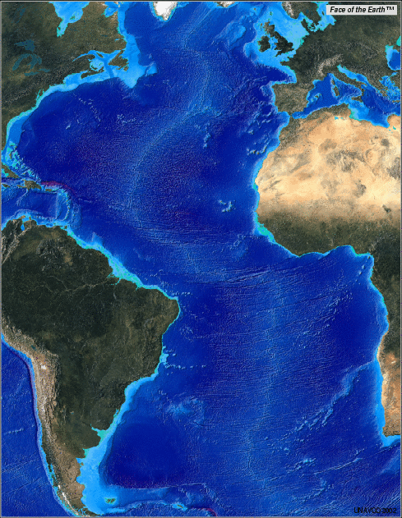
The Mid Atlantic Ridge is formed by Diverging Oceanic Plates
It is an area in the middle of the Atlantic ocean that is forming an ocean ridge during sea floor spreading

Slide 26
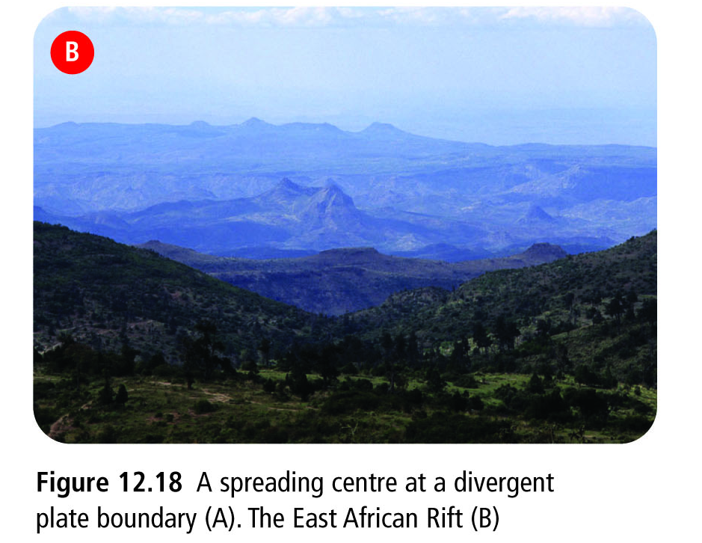
Divergent plates over land…
When tectonic plates diverge, pull apart over land, the spreading center is called a RIFT VALLEY.
This is less
common than
spreading
over water

Slide 27
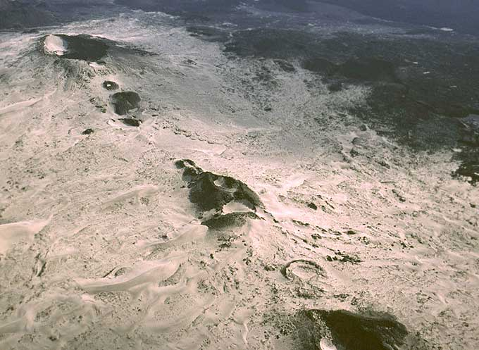

Slide 28
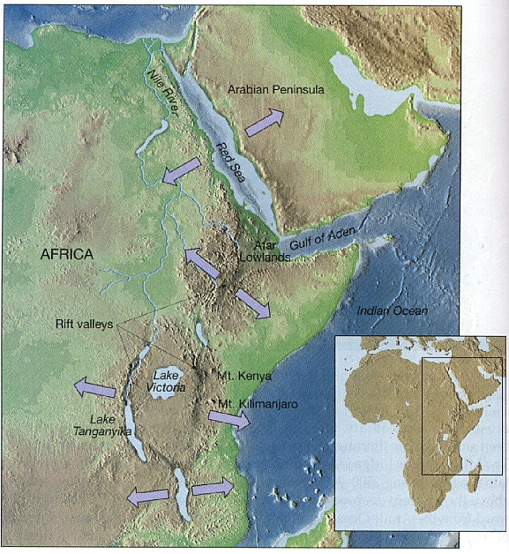
Diverging plates in eastern Africa are slowly breaking Africa into pieces creating rift valleys at the spreading centers

Slide 29
#2- CONVERGENT Boundaries
When 2 plates move toward each other
The plates will do 1 of 2 things:
  One plate will sink underneath of the other plate, this is called SUBDUCTION
  The two plates will collide with one another without the sinking of the plates
There are 3 types of Convergence:
  Oceanic- Continental
  Oceanic-Oceanic
  Continental-Continental

Slide 30
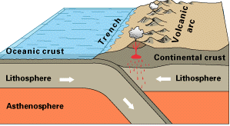
Convergent Plates with Subduction

Slide 31
When Subduction occurs – the edge of the plate subducts (goes under the other plate) deep into the mantle and starts to melt creating magma.
When the plate subducts, it “pulls” the rest of the plate with it (similar to you falling into the pool and grabbing a friend who also falls into the pool with you) - This is called SLAB PULL
This slab pull helps keep the tectonic plates in motion.

Slide 32
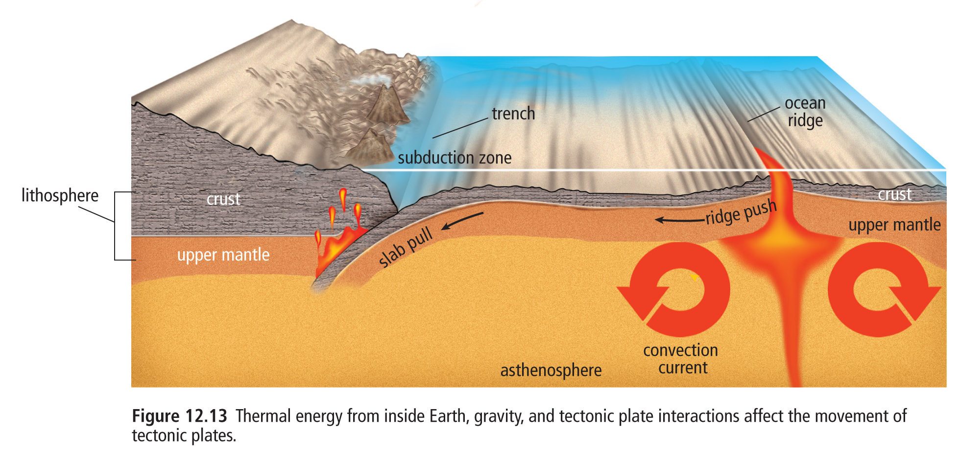
Subduction, Ridge push, and Slab pull

Slide 33
1. Oceanic-Continental Plate Convergence…
When a dense (heavier) oceanic plate collides with a less-dense (lighter) continental plate, the oceanic plate subducts.
This creates a deep underwater valley called a TRENCH.
As the subducting plate moves deeper, magma can work its way to the surface forming cone-shaped Volcanoes
A chain of volcanoes = VOLCANIC BELT
This force of collision between the 2 plates creates mountain ranges as the continental rock crumbles and folds

Slide 34
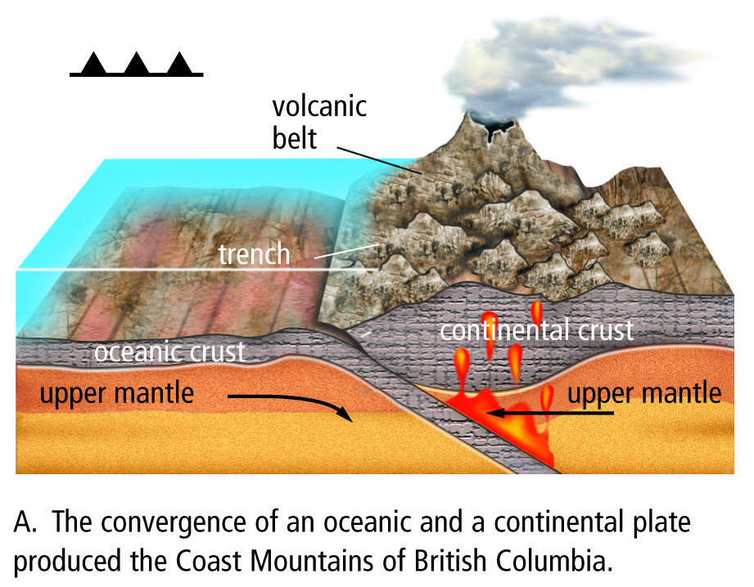
Symbol for converging plates

Slide 35
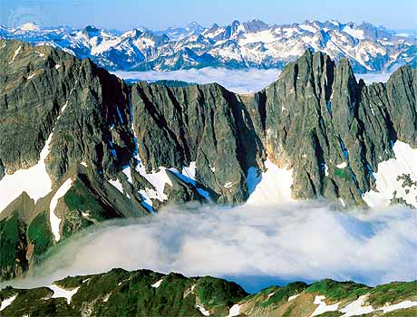
Volcanic Belt- Cascade Range

Slide 36
2. Oceanic - Oceanic Plate Convergence…
Subduction occurs when 2 oceanic plates converge/collide.
The denser plate subducts under the other, and the subducting plate sinks deep into the mantle
This interaction may produce a long chain of volcanic islands known as a VOLCANIC ISLAND ARC ( ie. Japan islands)

Slide 37
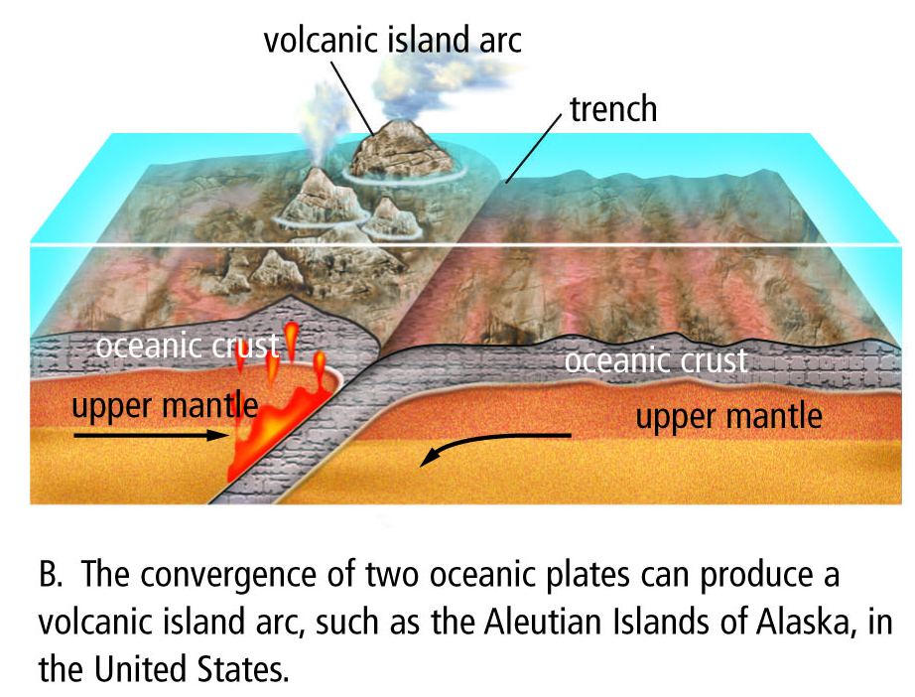

Slide 38
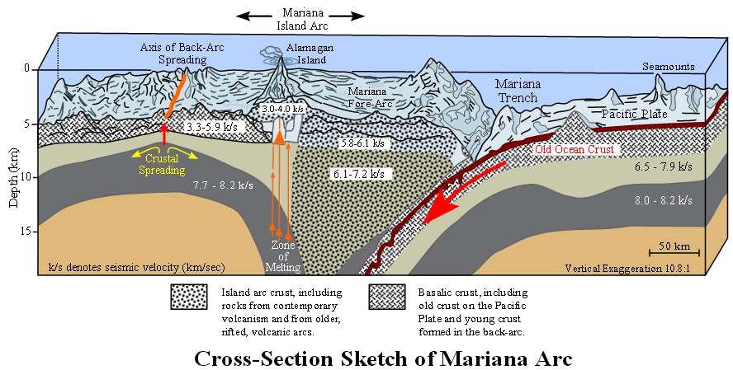

Slide 39
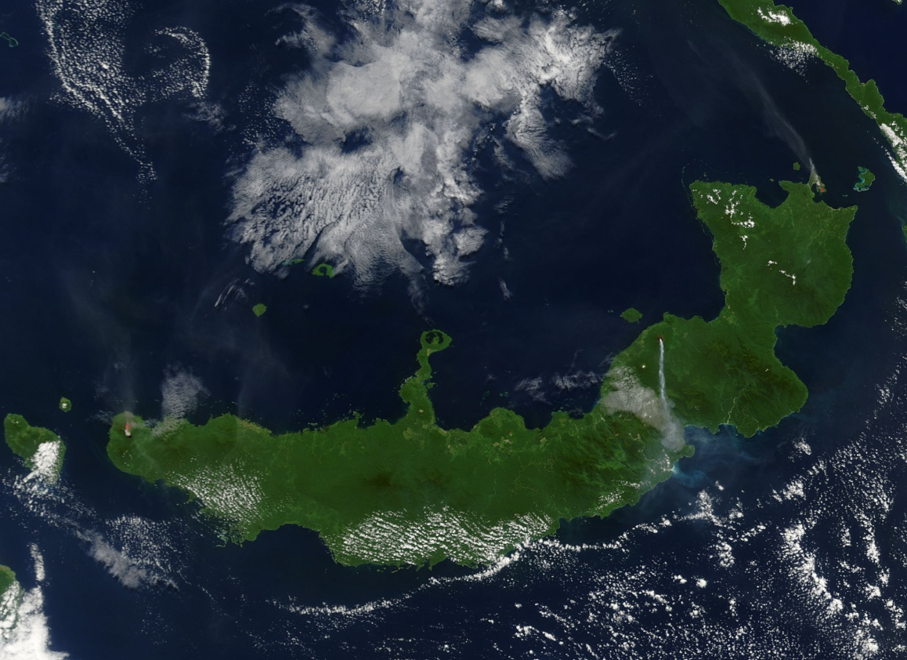
Volcanic Island Arc

Slide 40
Continental - Continental Plate Convergence…
When continental plates collide, subduction DOES NOT occur because the plates are the same density.
Instead, the plates hit head on and their edges crumple and fold forming great Mountain ranges ( ie. The Himalayas)
The Himalayas are the highest and youngest mountain range and are increasing in height several cm a year due to continuous convergence of the plates!

Slide 41
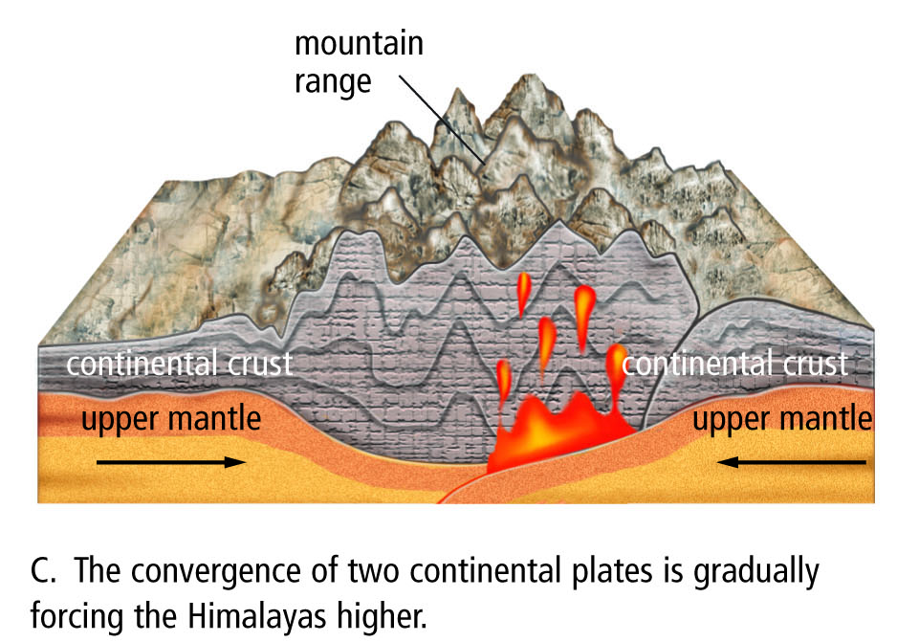

Slide 42
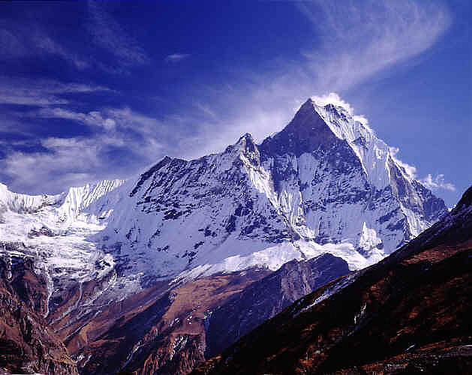
Mountain Ranges
The Himalayas – highest point is Mount Everest and they are found in Asia

Slide 43
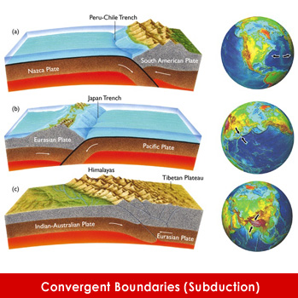

Slide 44
#3- Transformation boundaries
2 plates slide past one another
Because they are sliding horizontally past each other – no mountains or volcanoes are formed
What do form are FAULTS and EARTHQUAKES
  Faults are cracks in the rock due to movement
TRANSFORM FAULTS are the name we give to the area where the plates slide

Slide 45
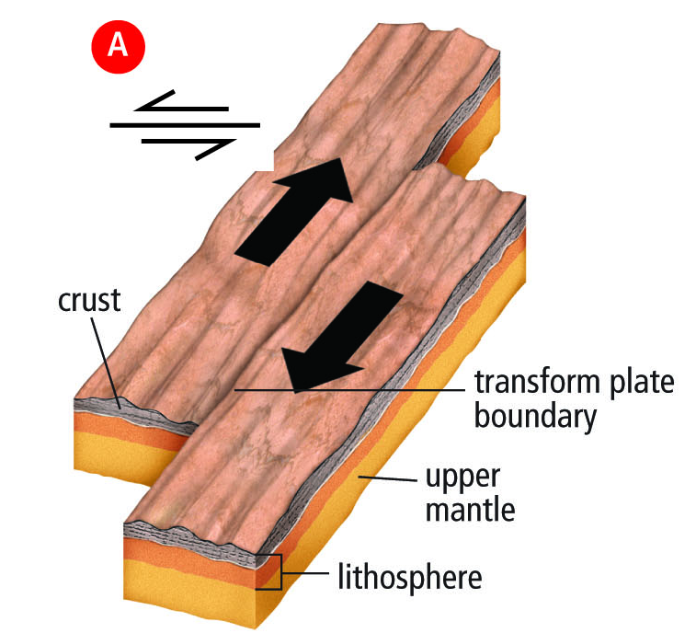
Transform Boundary
This is the symbol on a map for transform boundaries

Slide 46
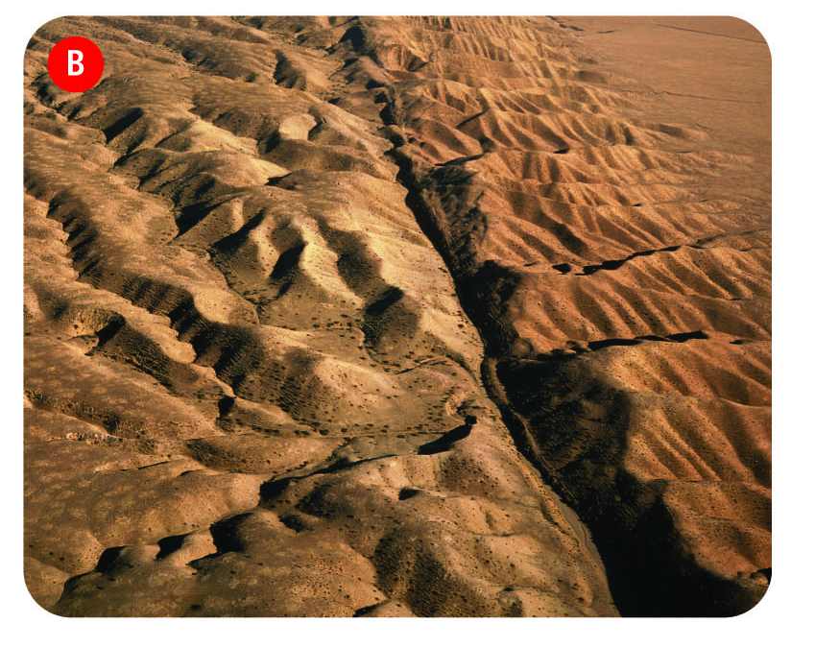
San Andreas Fault in California

Slide 47
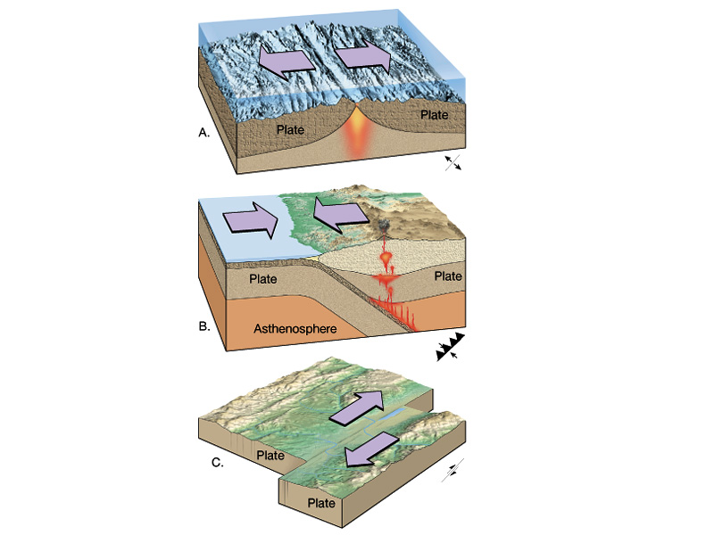
So… 3 Types of Plate Boundaries
DIVERGENT
CONVERGENT
TRANSFORM

Slide 48
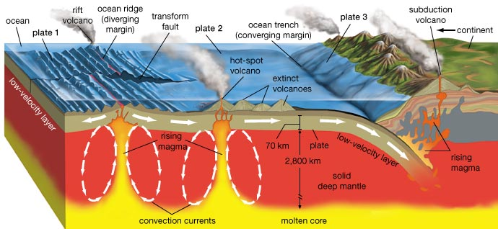
When you are really good.. You can understand this whole diagram…

