Slide 1
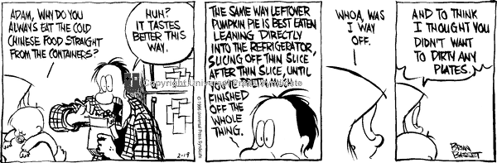
_________ Boundaries
Plate

Slide 2
Today’s Objectives
Define and Describe the 2 different types of tectonic plates
  Oceanic
  Continental
Describe and Define the 3 ways in which plates can interact:
  Diverging (pulling apart)
  Converging (coming together)
  Transforming (sliding past)
Define and Describe
  Ridge Push
  Slab Pull

Slide 3
Two Types of Plates
Oceanic Plate:
  More Dense and Heavy
  Made of a specific rock called BASALT
Continental Plate:
  Less dense and Light
  Made of a specific rock called GRANITE
  When these two types of plates interact, the Oceanic Plate ALWAYS sinks below the continental plate.

Slide 4
Plate Boundaries…
At the edges of the plates is where all the action occurs
When Plates move – there are only 3 choices they have…
1) Separate from each other (DIVERGE)
2) Crash directly into each other and one goes under the other (CONVERGE)
3)Slide past/along one another (TRANSFORM)

Slide 5
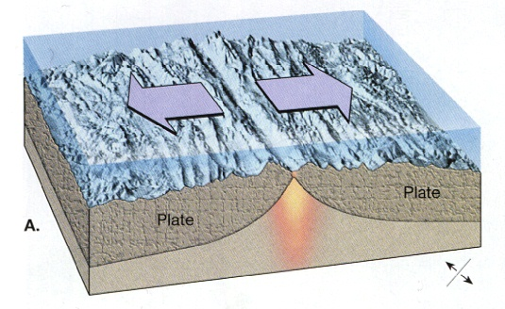
3 Types of Plate Boundaries
#1-DIVERGENT boundaries
2 plates move away from each other opening a gap called a spreading center
There are 2 types:
  Oceanic-Oceanic
  Continental- Continental

Slide 6
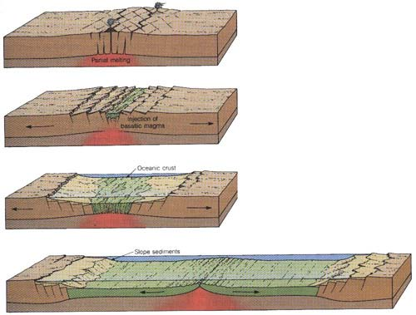
As molten rock comes up through the crack created by the diverging plates, it pushes the old crust aside causing it to buckle.
This process is called RIDGE PUSH

Slide 7
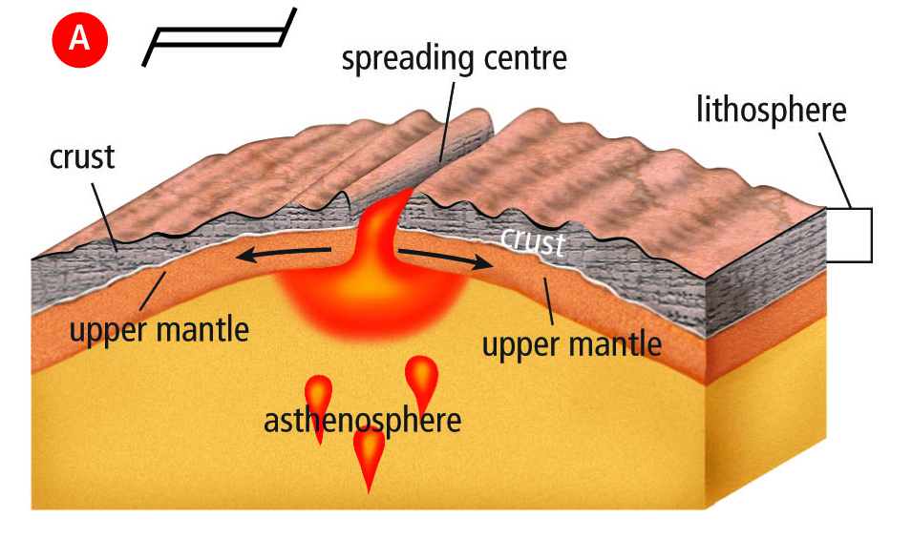
Divergent…
This is the symbol on a map for divergent boundaries
RIDGE PUSH

Slide 8
Divergent plates over water…
When tectonic plates diverge, pull part, over water, the spreading center is called SPREADING RIDGEor OCEANIC RIDGE.
Because the magma rising up through the trench and pushes the old crust aside, new sea floor is created
This is called SEA FLOOR SPREADING

Slide 9
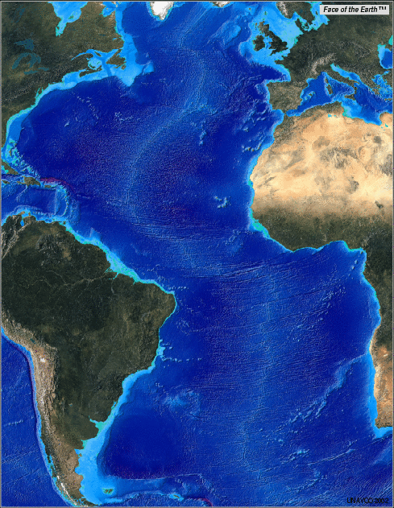
The Mid Atlantic Ridge is formed by Diverging Oceanic Plates
It is an area in the middle of the Atlantic ocean that is forming an ocean ridge during sea floor spreading

Slide 10
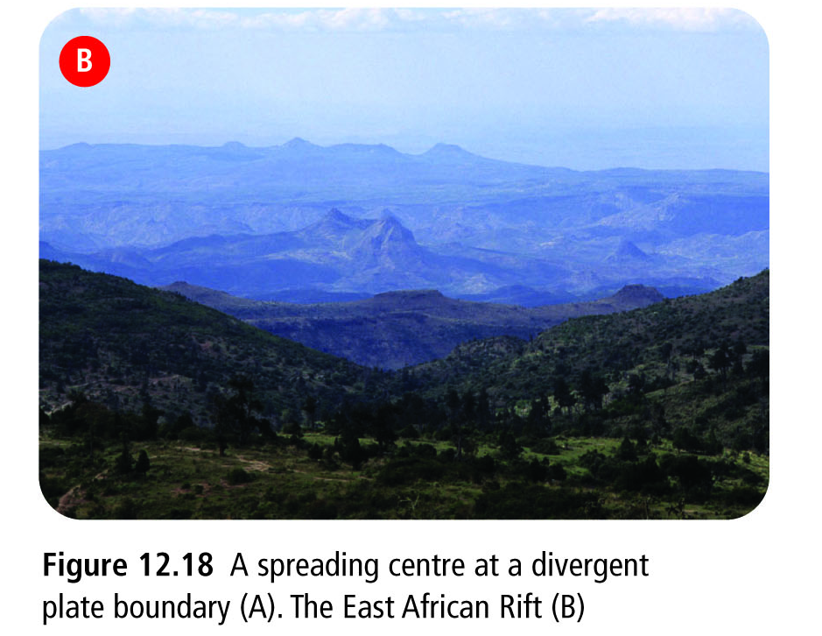
Divergent plates over land…
When tectonic plates diverge, pull apart, over land, the spreading center is called a RIFT VALLEY.
This is less
common than
spreading
over water

Slide 11
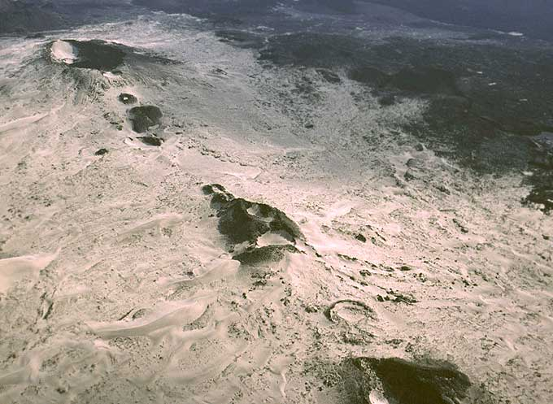

Slide 12
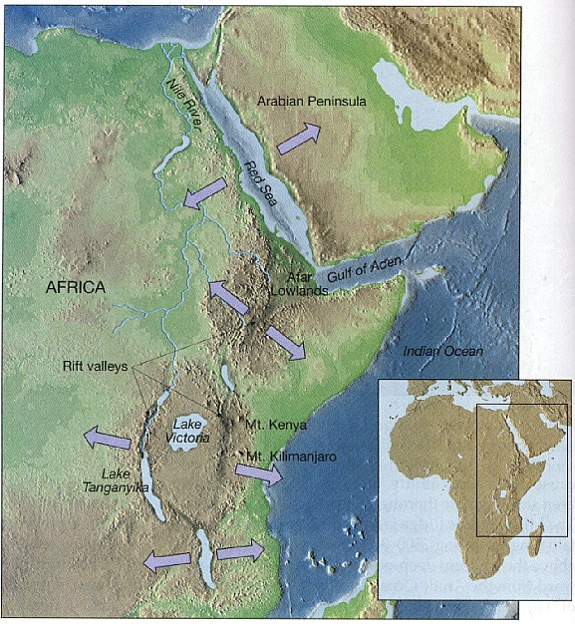
Diverging plates in eastern Africa are slowly breaking Africa into pieces creating rift valleys at the spreading centers

Slide 13
#2- CONVERGENT Boundaries
When 2 plates move toward each other
The plates will do 1 of 2 things:
  One plate will sink underneath of the other plate, this is called SUBDUCTION
  The two plates will collide with one another without the sinking of the plates
There are 3 types of Convergence:
  Oceanic- Continental
  Oceanic-Oceanic
  Continental-Continental

Slide 14
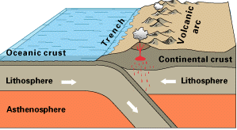
Convergent Plates with Subduction

Slide 15
When Subduction occurs – the edge of the plate subducts deep into the mantle and starts to melt creating magma.
When the plate subducts, it “pulls” the rest of the plate with it - This is called SLAB PULL
( the whole slab is pulled under the other slab)
This slab pull helps keep the tectonic plates in motion.

Slide 16
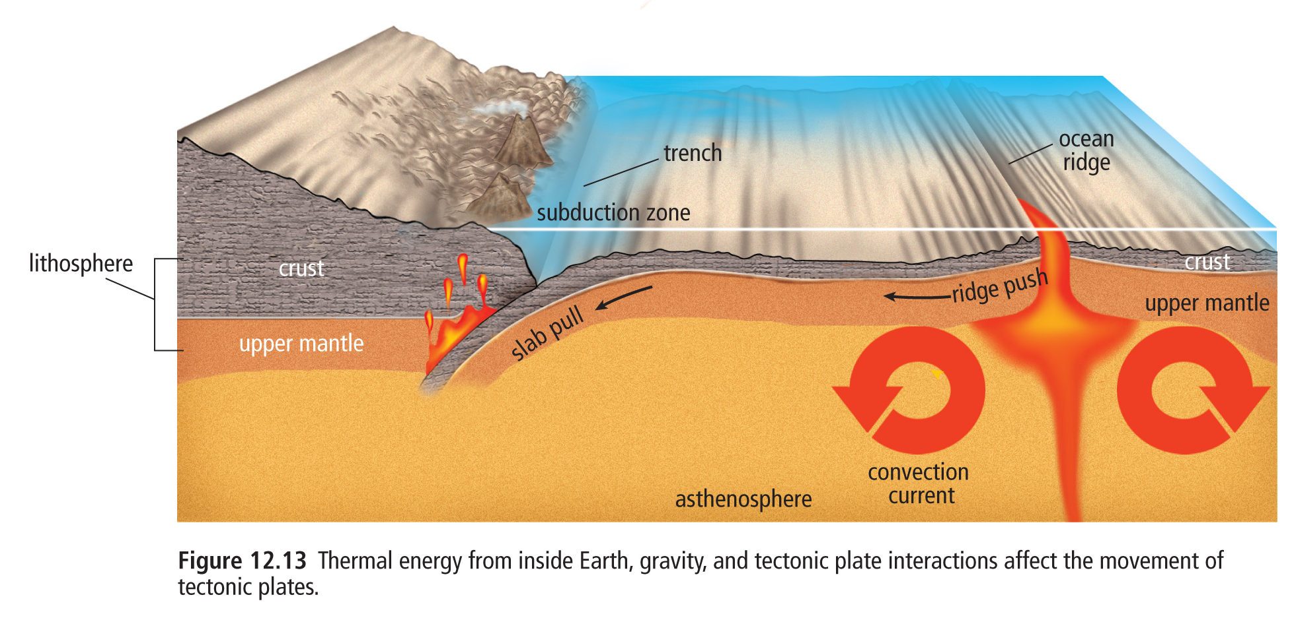
Subduction, Ridge push, and Slab pull

Slide 17
Oceanic-Continental Plate Convergence…
When a dense (heavier) oceanic plate collides with a less-dense (lighter) continental plate, the oceanic plate subducts.
This creates a deep underwater valley called a TRENCH.
As the subducting plate moves deeper, magma can work its way to the surface forming cone-shaped Volcanoes
A chain of volcanoes = VOLCANIC BELT
This force of collision between the 2 plates creates mountain ranges as the continental rock crumbles and folds

Slide 18
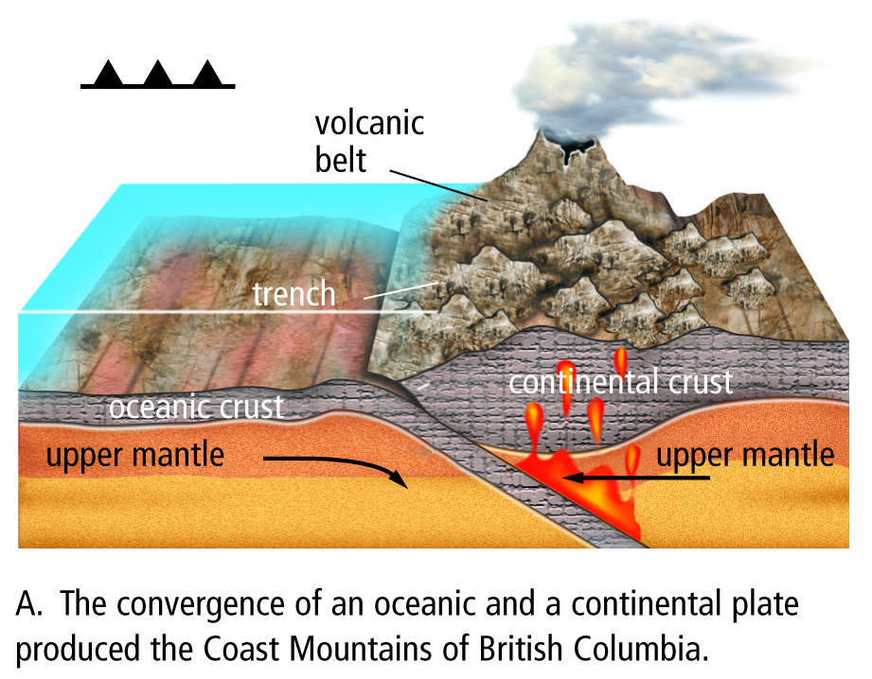
Symbol for converging plates

Slide 19
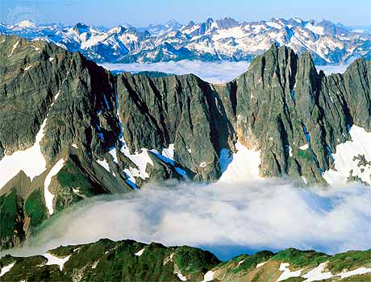
Volcanic Belt- Cascade Range

Slide 20
Oceanic - Oceanic Plate Convergence…
Subduction occurs when 2 oceanic plates converge/collide.
The denser plate subducts under the other, and the subducting plate sinks deep into the mantle
This interaction may produce a long chain of volcanic islands known as a VOLCANIC ISLAND ARC ( ie. Japan islands)

Slide 21
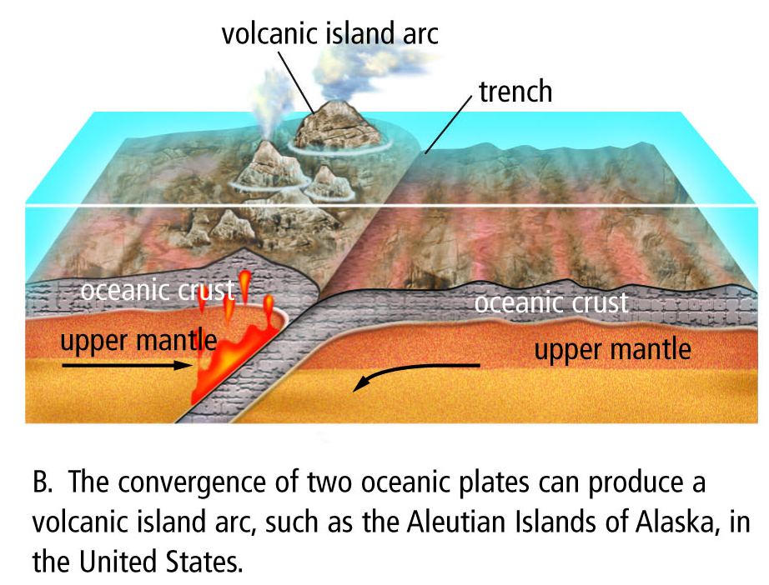

Slide 22
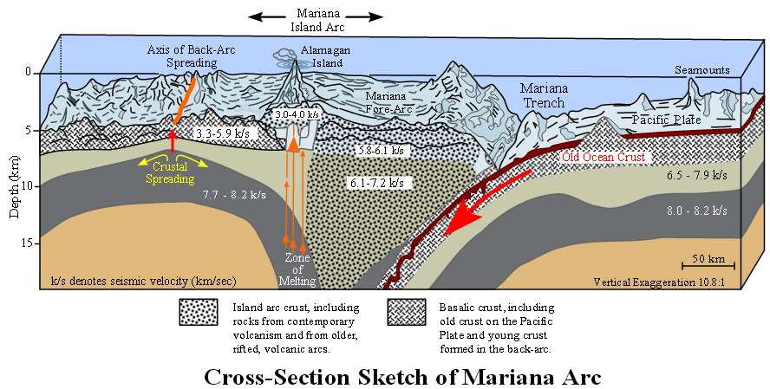

Slide 23
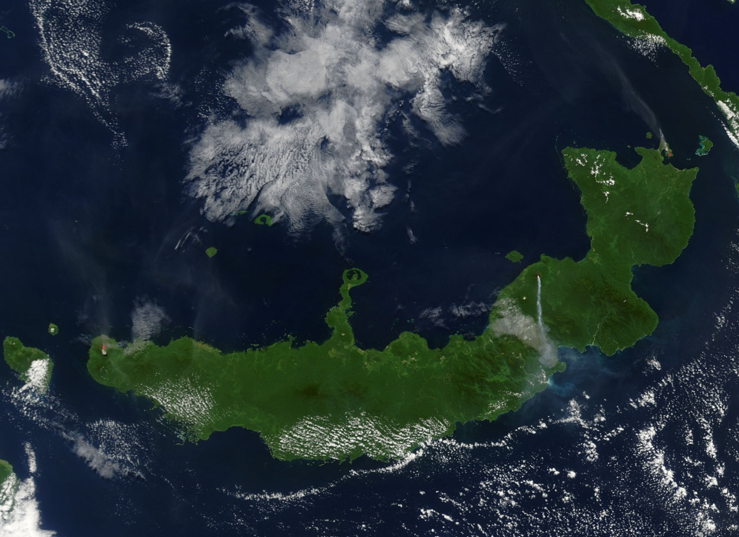
Volcanic Island Arc

Slide 24
Continental - Continental Plate Convergence…
When continental plates collide, subduction DOES NOT occur because the plates are the same density.
Instead, the plates hit head on and their edges crumple and fold forming great Mountain ranges ( ie. The Himalayas)
The Himalayas are the highest and youngest mountain range and are increasing in height several cm a year due to continuous convergence of the plates!

Slide 25
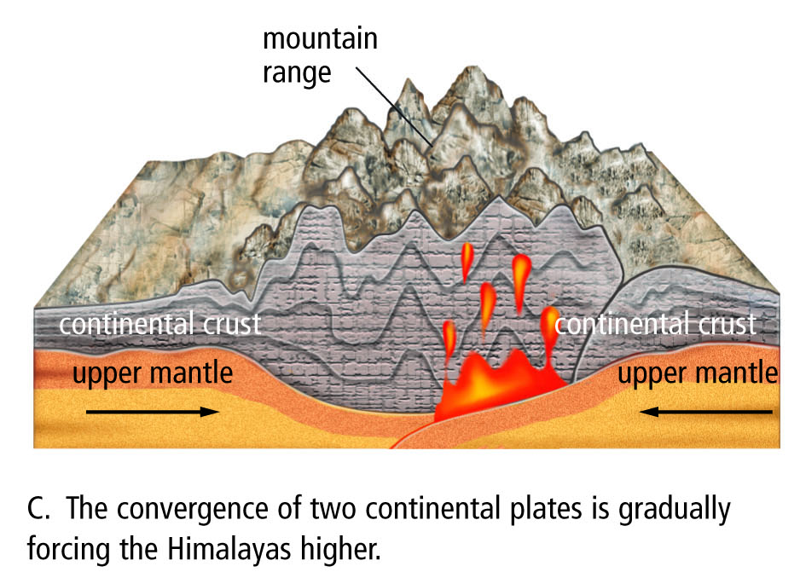

Slide 26
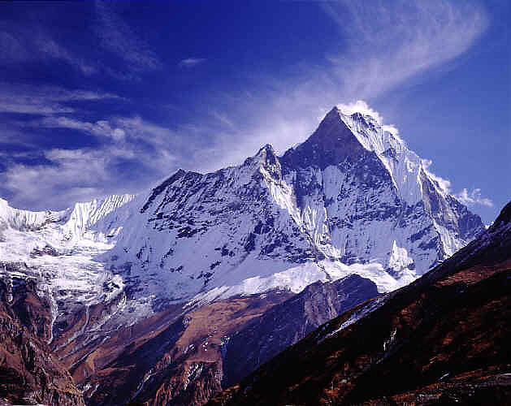
Mountain Ranges
The Himalayas – highest point is Mount Everest and they are found in Asia

Slide 27
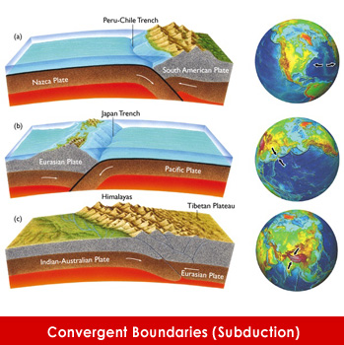

Slide 28
#3- Transformation boundaries
2 plates slide past one another
Because they are sliding horizontally past each other – no mountains or volcanoes are formed
What do form are FAULTS and EARTHQUAKES
  Faults are cracks in the rock due to movement
TRANSFORM FAULTS are the name we give to the area where the plates slide

Slide 29
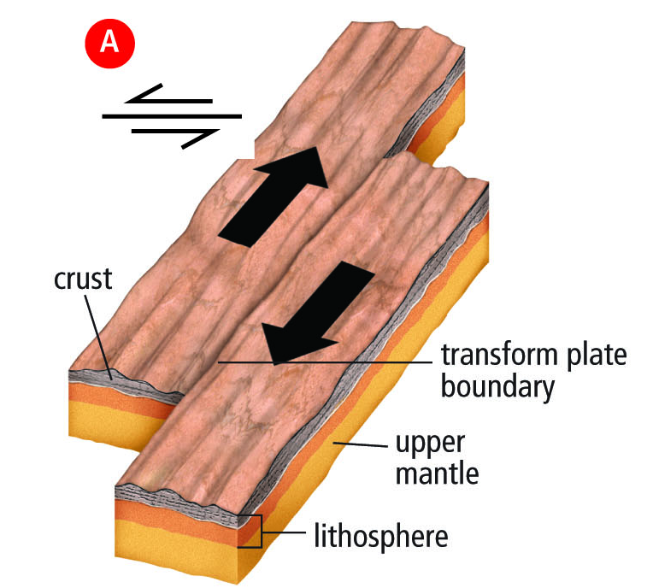
Transform Boundary

Slide 30
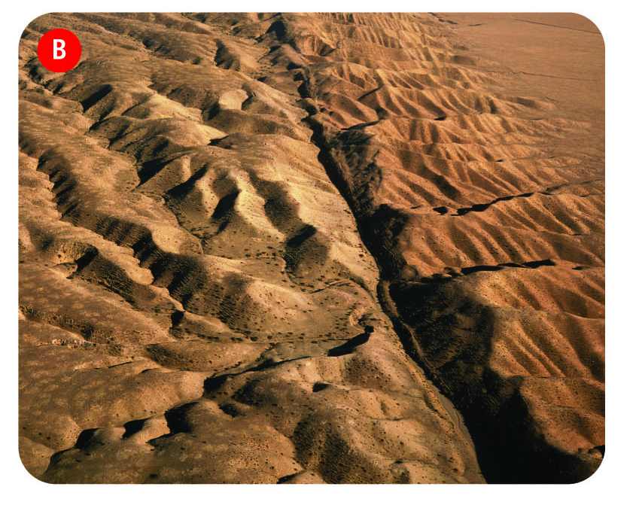
San Andreas Fault in California

Slide 31
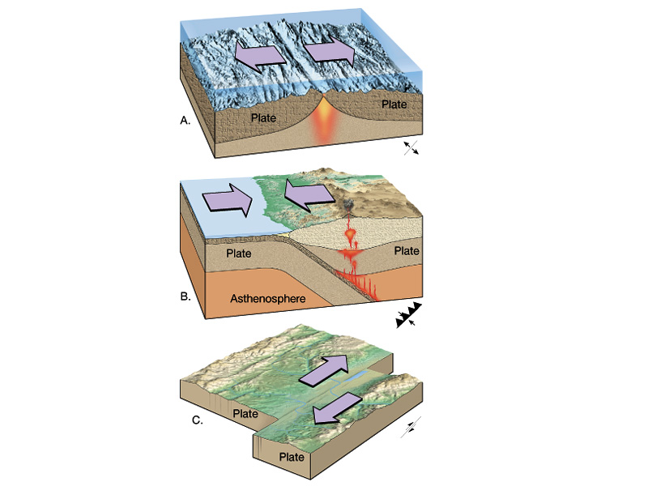
So… 3 Types of Plate Boundaries
DIVERGENT
CONVERGENT
TRANSFORM

Slide 32
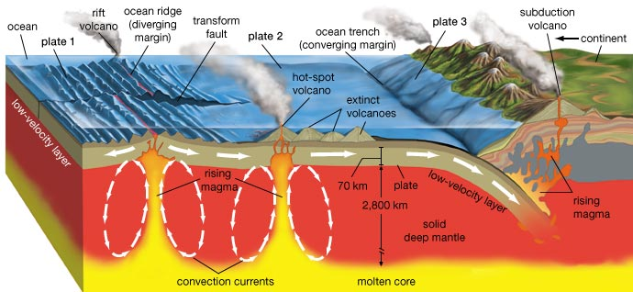
When you are really good.. You can understand this whole diagram…

