Slide 1
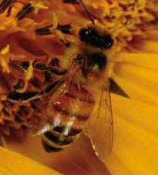
2.1 Energy Flow in Ecosystems
Biomass is the total mass of all living things in a given area.
Biomass is generally measured in g/m² or kg/m² .
Within an organism’s niche, the organism interacts with the ecosystem by:
Obtaining food from the ecosystem
Contributing energy to the ecosystem
Plants are called producers because they produce
sugars from carbon dioxide, water, and the Sun’s energy.
Consumers get their energy by feeding on producers or other consumers.
Decomposition is the breakdown of wastes and dead organisms by organisms called decomposers through the process of biodegradation.
Bees are consumers.

Slide 2
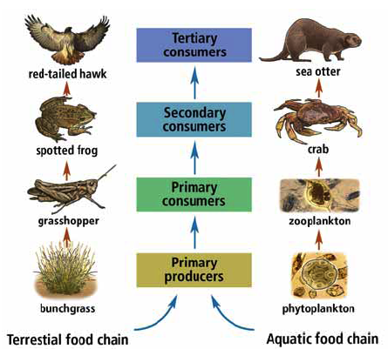
Energy Flow and Energy Loss in Ecosystems: Food Chains
Scientists use different methods to represent energy moving through ecosystems.
Food chains
Food webs
Food pyramids
Food chains show the flow of
energy in an ecosystem.
Each step in a food chain is a trophic level
Producers = 1st trophic level
Primary consumers = 2nd trophic level
Secondary consumers = 3rd trophic level
Tertiary consumers = 4th trophic level
Examples of terrestrial and aquatic food chains

Slide 3
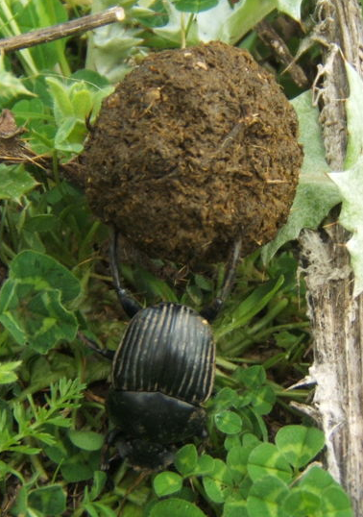
Energy Flow and Energy Loss in Ecosystems: Food Chains (continued)
Consumers in a food chain can be classified as:
Detrivores – consumers that obtain energy and nutrients from dead organisms and waste matter
Examples include earthworms, bacteria and fungi.
Detrivores feed at every trophic level.
Detrivores have their own, separate food chains
and are very numerous.
Herbivores – primary consumers
Herbivores eat plants (producers) only.
Carnivores – secondary or tertiary consumers
Secondary consumers eat non-producers, such as herbivores.
Tertiary consumers eat secondary consumers.
Also called top consumers or top carnivores.
Omnivores – consumers that eat both plants and animals
Examples include humans and bears.
This dung beetle is a detrivore.

Slide 4
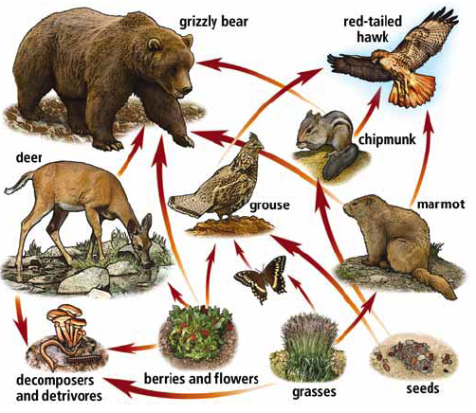
Energy Flow and Energy Loss in Ecosystems: Food Webs
Most organisms are part of many food chains.
Food webs represent interconnected food chains.
Food webs are models of the feeding relationships in an ecosystem.
Arrows in a food web represent the flow of energy and nutrients.
Following the arrows leads to the top carnivore(s).
This food web represents a terrestrial ecosystem that could be found in British Columbia.

Slide 5
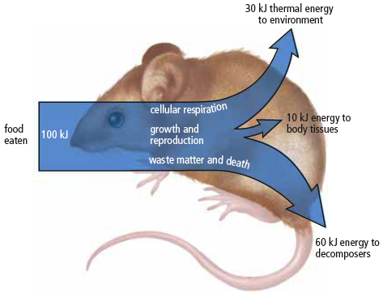
Energy Flow and Energy Loss in Ecosystems: Food Pyramids
Food pyramids show the changes in available energy from one trophic level to another in a food chain.
Energy enters at the first trophic level (producers), where there is a large amount of biomass and therefore much energy.
It takes large quantities of organisms in one trophic level to meet the energy needs of the next trophic level.
Each level loses large amounts of the energy
it gathers through basic processes of living.
80 – 90 percent of energy taken in by consumers is used in chemical reactions
in the body and is lost as thermal energy.
There is very little energy left over for growth or increase in biomass.
Ninety percent of this mouse’s food energy is used to maintain its life functions.

Slide 6
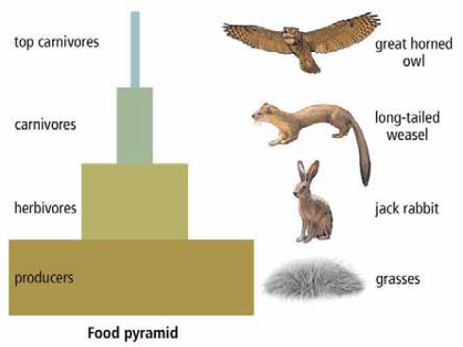
Energy Flow and Energy Loss in Ecosystems: Food Pyramids (continued)
Food pyramids are also known as ecological pyramids.
Ecological pyramids may show biomass, population, or energy numbers.
The amount of life an ecosystem can contain is based on the bottom level of the ecological pyramid, where producers capture energy from the Sun.
Each level in the energy pyramid = a loss of 90 percent of total energy available.
Lower trophic levels have much
larger populations than upper levels.
This shows the importance of
maintaining large, biodiverse
populations at the lowest levels
of the food pyramid.

Slide 7
