Slide 1
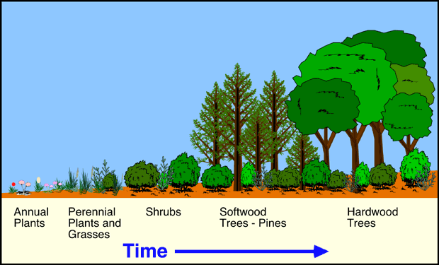
Natural Changes in Ecosystems
BC Science 10 – Section 3.1 (pg. 108 – 121)

Slide 2
Today’s Objectives
Explain various ways in which natural populations are altered or kept in equilibrium, including:
Explain how species adapt or fail to adapt to environmental conditions, with reference to: natural selection, ecological succession, climax community, extinction, adaptive radiation
Describe the impact of natural phenomena (drought, fire, temperature change, flooding, tsunamis, infestations, volcanic eruptions) on ecosystems

Slide 3
A long time ago….
The water level of the oceans was much higher than they are today
As the water dropped, new lakes were formed and some species of fish were separated: some in the ocean, some in the lakes

Slide 4
Natural Selection and Adaptive Radiation
The fish in the lakes needed to eat different food, and had different predators than those in the ocean
When a species environment changes, their bodies also change to adapt to that environment and new species are created from one original species
This is called adaptive radiation
The ability of living organisms to change to better adapt to their environment is called natural selection
The changes allow the organisms to have an advantage over other members of that species, and they will have better chance to mate, and these advantages are passed on to their offspring

Slide 5
Example: Stickleback Fish
Ocean Stickleback
Lake Sticklebacks
Sharp spines and armour-like plates on the body protects against many large marine (ocean) predators
Top: bottom feeding stickleback has a large body and big mouth, less armour
Bottom: open-water feeding stickleback has smaller, thinner body and more armour…..why?

Slide 6
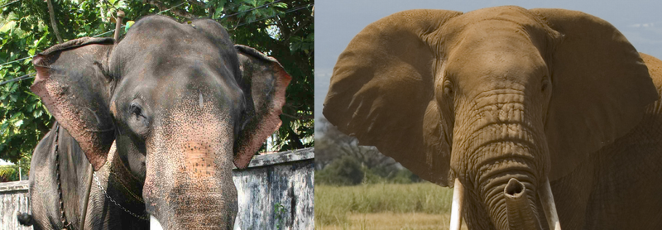
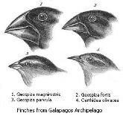
Can you think of any other examples of adaptive radiation?
African/Asian Elephant:
African Elephants have larger ears
Help them keep cool in warmer environment
Galapagos Finches (pg. 110)
These birds eat different foods, so their beaks changed to better suit their diet

Slide 8
Definition: Ecological Succession
Natural, gradual changes in the types of species that live in an area; can be primary succession or secondary succession
The gradual replacement of one plant community by another through natural process over time
Primary: 100’s of years
Secondary: 10’s of years

Slide 9
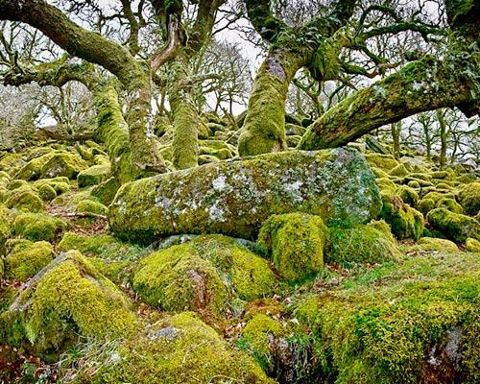
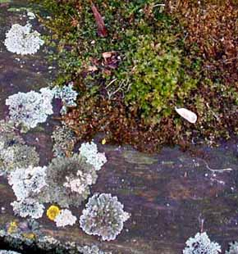
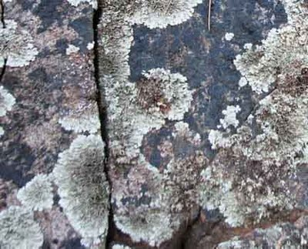
Primary Succession
Begins in a place without any soil
Sides of volcanoes
Landslides
Flooding
Starts with the arrival of living things such as lichens and mosses that do not need soil to survive
Called pioneer species
Lichens on rocks

Slide 10
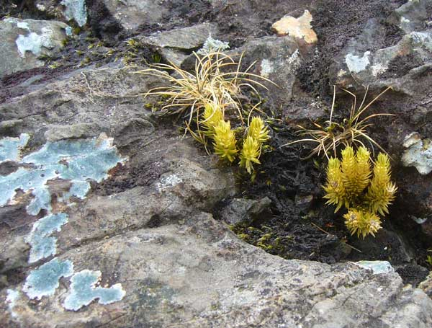
Primary Succession
Soil starts to form as lichens and the forces of weather and erosion help break down rocks into smaller pieces
When lichens die, they decompose, adding small amounts of organic matter (and nutrients) to the rock to make soil

Slide 11
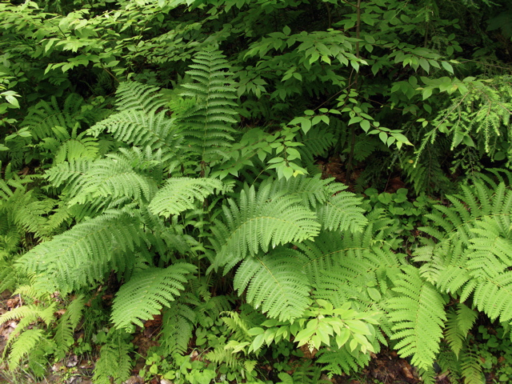
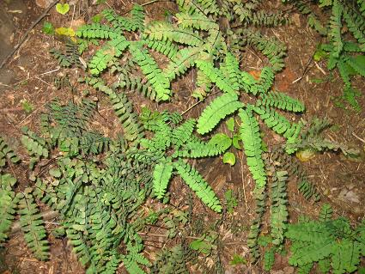
Primary Succession
Simple plants like ferns and grasses can now grow

Slide 12
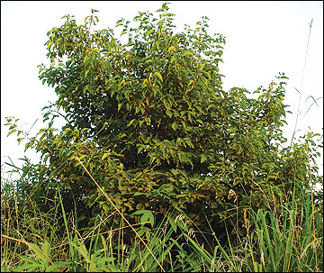
Primary Succession
These simple plants die, adding more soil, organic material, and nutrients
The soil layer thickens, and larger plants such as shrubs can grow and begin to take over

Slide 13
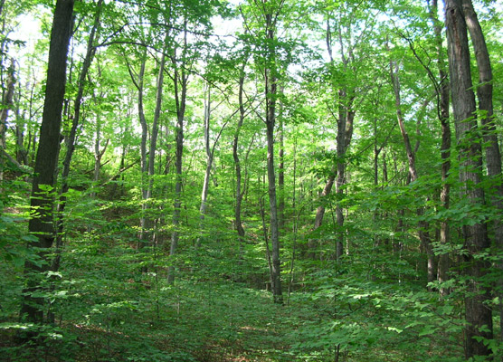
Primary Succession
These plants die, add more nutrients to the soil
Larger shrubs and trees can survive now

Slide 14
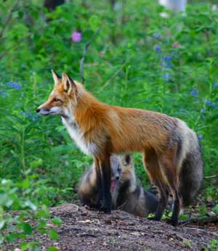
Primary Succession
Insects, small birds, and mammals have begun to move in
What was once bare rock now supports a variety of life
A stable group of plants and animals that is the end result of the succession process is called a climax community
Does not always mean big trees!
Grasses in the prairies
Cacti in deserts

Slide 15
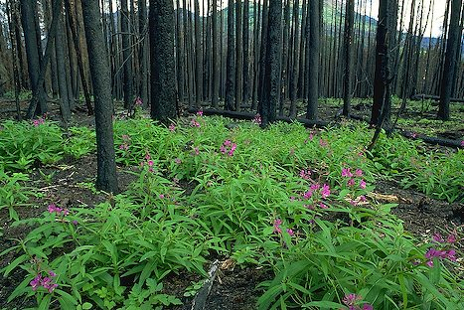
Secondary Succession
Secondary Succession is different from primary succession because it begins in a place that already has soil and was once the home of living organisms
It occurs faster and has different pioneer species (grass, flowers) than primary succession
Example: after a forest fire

Slide 16
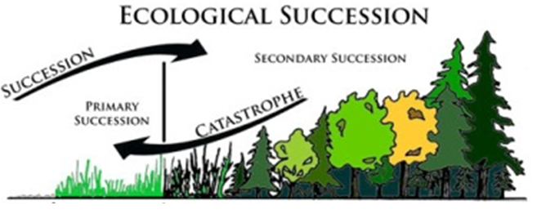
The Cycle of Ecological Succession

Slide 17
Ecological Succession: A little video

Slide 18
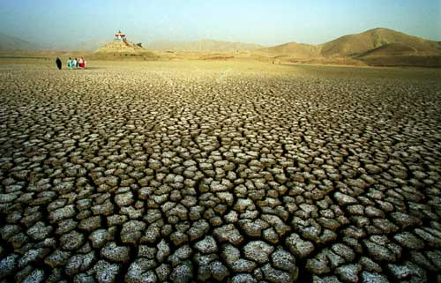
Natural Events That Affect Ecosystems
Drought: Definition
Occurs when below-average amounts of precipitation in an area over a period of many months
Most often a biome can recover

Slide 19
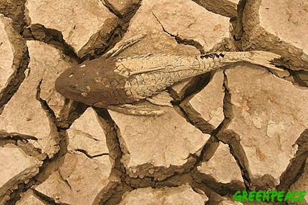
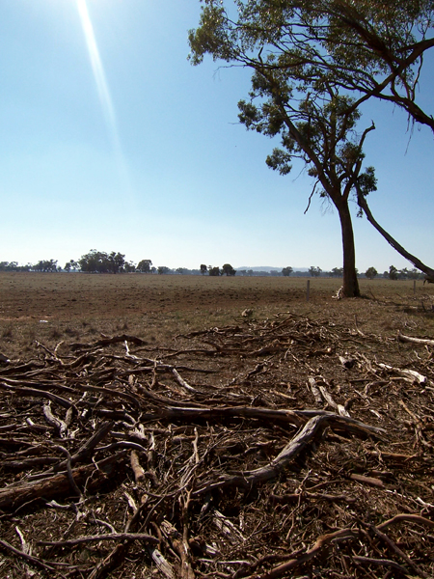
Drought: Effects
The effects of prolonged drought can:
Destroy habitat
Cause plants and animals to die
Result in crop failure and livestock death

Slide 20
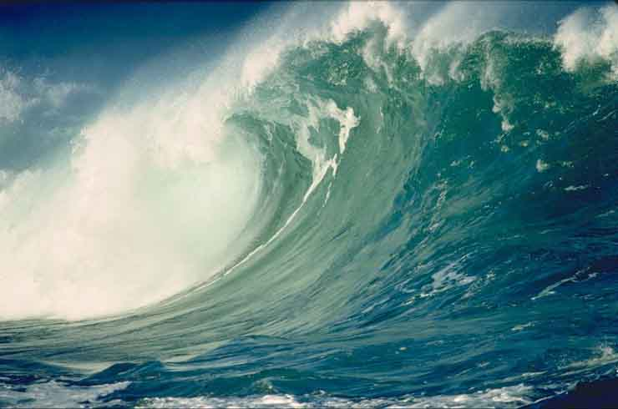
Tsunamis: Definition
Huge, rapidly moving ocean wave caused by seismic waves (released by an earthquake or volcanic eruption)

Slide 21
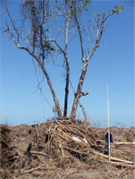
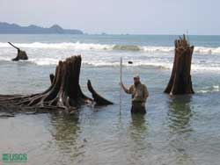
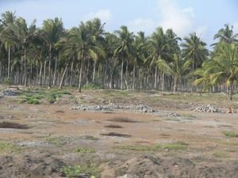
Tsunamis: Effects
On land, force of the wave carries away or destroys plants and animals; and can disrupt habitat and food webs
The large volume of salt carried onto the shore can change the composition of the soil, causing plants to be unable to grow

Slide 22
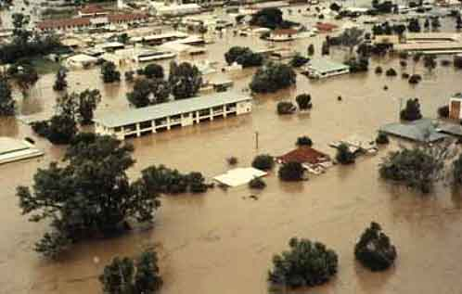
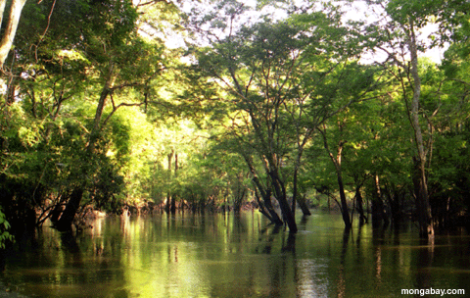
Flooding: Definition
Occurs in coastal areas, rivers and lakes, when the volume of water exceeds the ability of the water body to contain it
Can be part of a normal cycle, result of heavy rainfall, increased run-off, or an extreme natural event

Slide 23
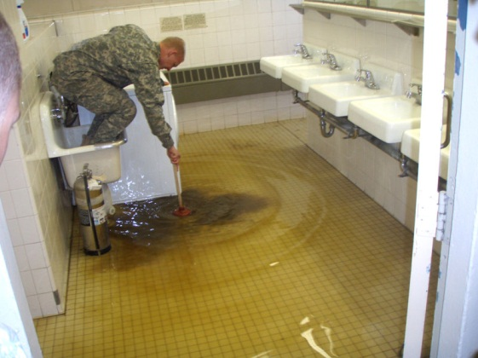
Flooding: Effects
Can result in soil erosion and soil pollution if toxic chemicals are present
Can cause widespread disease among humans when toxins or bacteria from sewage enters drinking water

Slide 24
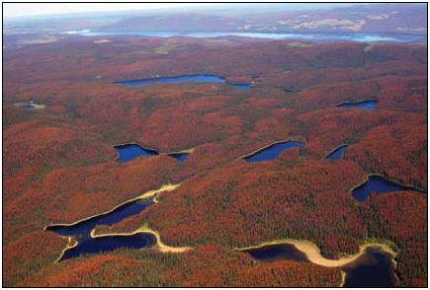
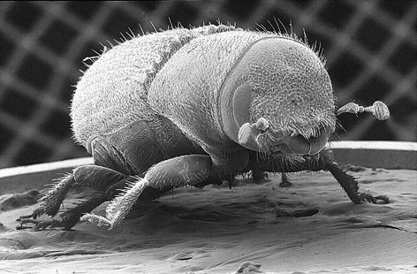
Insect Infestations: Effects
Insects play a natural role in forest succession, recycling nutrients to the soil.
Younger, healthy trees produce resin to defend against insects by flushing them out of the tree
When too many insects attack, like in an infestation, the natural defense systems are no longer effective
This changes the natural pattern of succession because insects attack both old and young trees, leaving none unaffected

Slide 25
Review Quiz!
With your partner, try to answer the following questions, I will call on some of you to answer them in class. Time: 3 minutes
1) What is adaptive radiation?
2) What is the purpose of natural selection?
3) How is primary succession different from secondary succession?
4) Explain how one of the natural events we discussed can negatively affect an ecosystem

Slide 26
Assignment: Modelling Primary and Secondary Succession
1) I will hand out to you a list of the stages of succession of two different ecosystems: ocean sand dune succession and pond succession
2) Put each list into the proper order of events
3) Choose one ecosystem and draw a seven stage cartoon showing one picture for each stage in the succession
4) Imagine that a natural event (flood, drought, tsunami, insect infestation) occurred in the climax community of your ecosystem
5) Draw three small sketches to illustrate the changes of secondary succession following the event
6) Write a short paragraph to describe how your ecosystem progressed through the stages of primary succession. Include the following terms in your paragraph: soil, pioneer species, changes, replaces, community, least biodiversity, most biodiversity, climax community
7) Due: Next Science Class (December 14)

