Slide 1
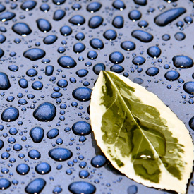
Biology
More Provincial Exam Practice!

Slide 2
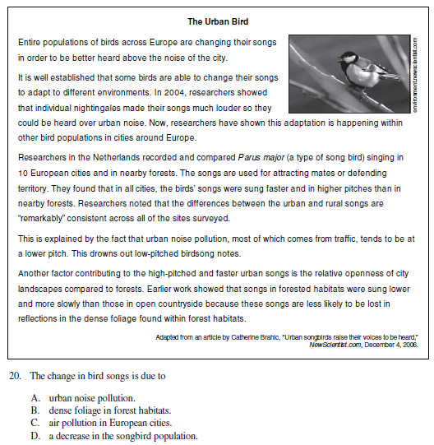
Strategies for answering article questions
1) Read the question first
2) Circle the key words
3) Search for the key words in the article and highlight those sentences
4) Read the answers to see which ones match the sentences in the article
5) Circle the correct answer and get it correct!

Slide 3
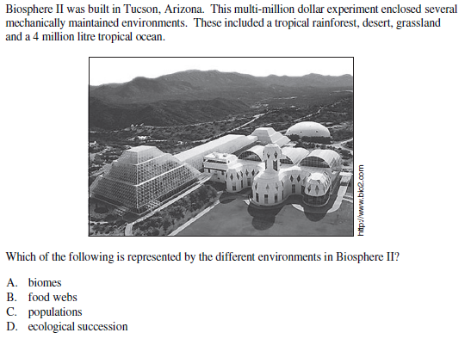
A- biomes

Slide 4
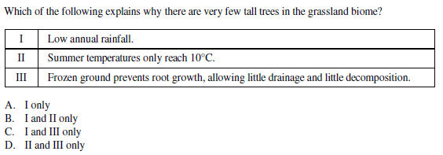
A – Low annual rainfall (grasslands are usually warm, no permafrost)

Slide 5
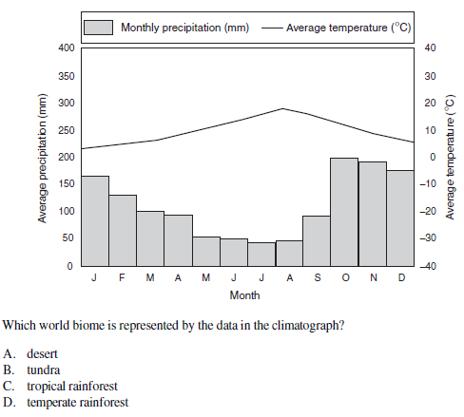
D – temperate rainforest (high rainfall, medium temperature)

Slide 6
C – photosynthesis (creates energy from sunlight)

Slide 7
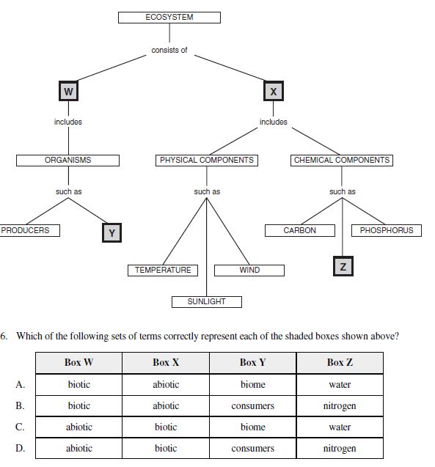
B

Slide 8
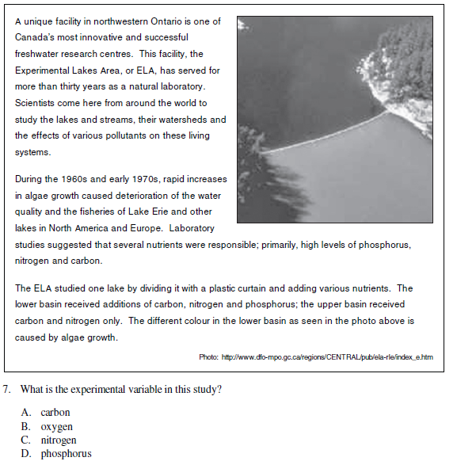
D - phosphorus

Slide 9
C – lake without alteration

Slide 10
D- apple eating insect (herbivore)

Slide 11
D – (rain washes away nutrients)

Slide 12
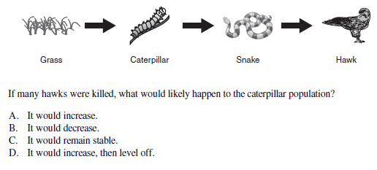
B – decrease (snakes increase)

Slide 13
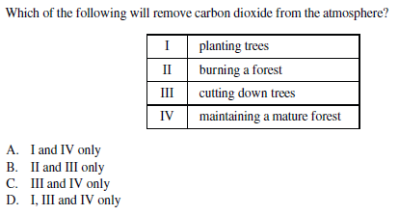
A – Plants take in carbon dioxide during photosynthesis

Slide 14
B – weathering (phosphorus often trapped in rocks, not found in atmosphere)

Slide 15
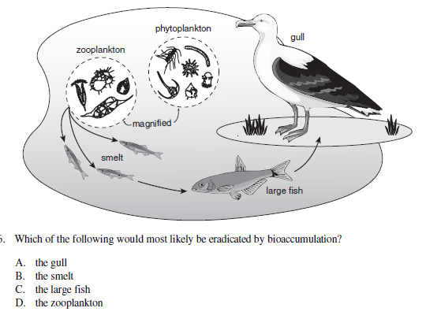
A – gull is highest trophic level

Slide 16
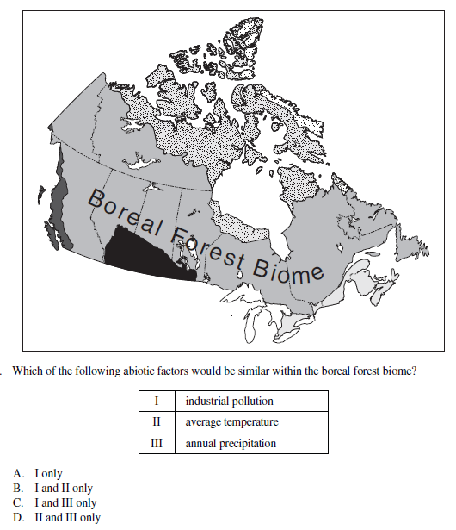
D – biomes have similar climate

Slide 17
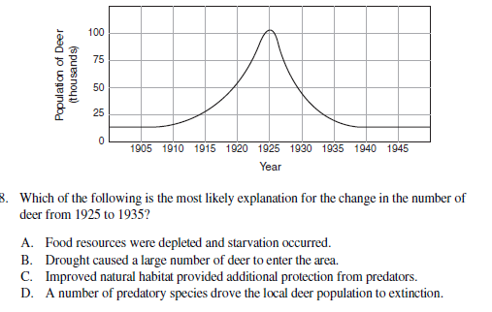
A – less food means decline in population, also not extinct

Slide 18
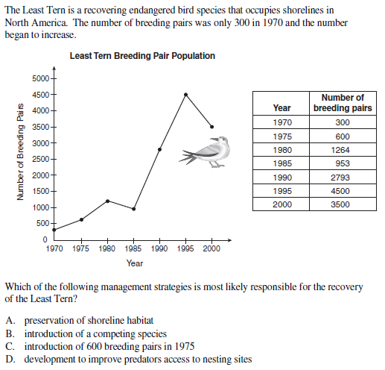
A

Slide 19
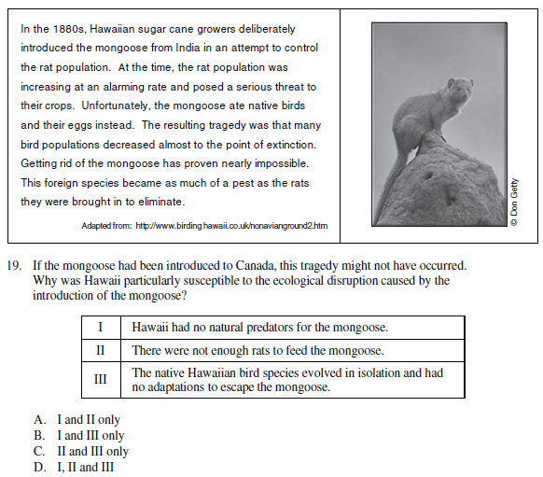
B

Slide 20
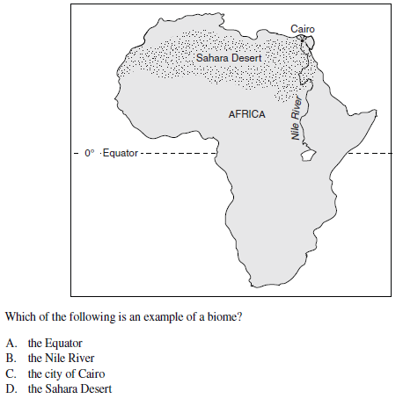
D – similar climate

Slide 21
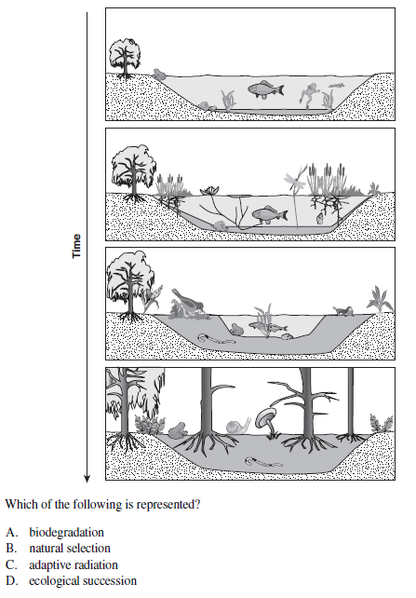
D – ecosystem changes over time

Slide 22
D – biotic = living

Slide 23
A – coniferous trees

Slide 24
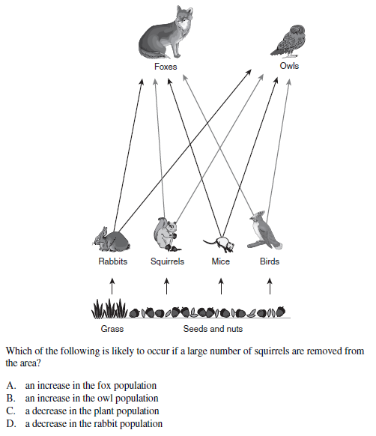
D – less squirrels to eat, so owls and foxes will eat more rabbits

Slide 25
D – marine sediments and sedimentary rock

Slide 26
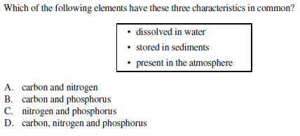
A – phosphorus not found in the atmosphere

Slide 27
A- both provide nutrients to the soil

Slide 28
D – always found near coastlines

Slide 29
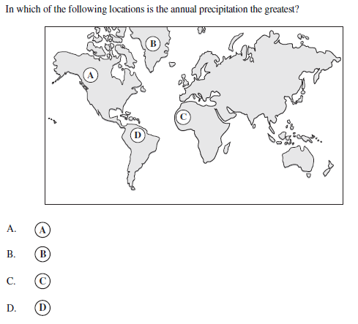
D – amazon rainforest

Slide 30
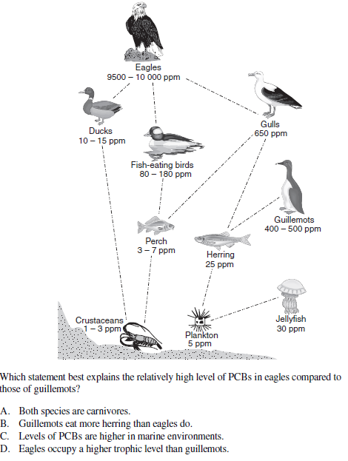
D - biomagnification

Slide 31
C – PCB concentrations

Slide 32
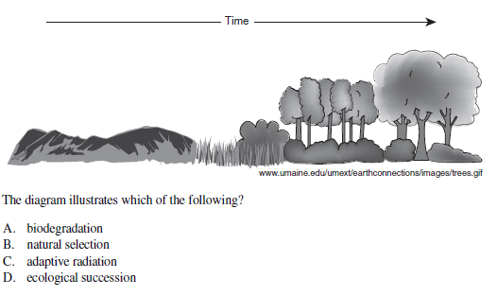
D – ecological succession

Slide 33
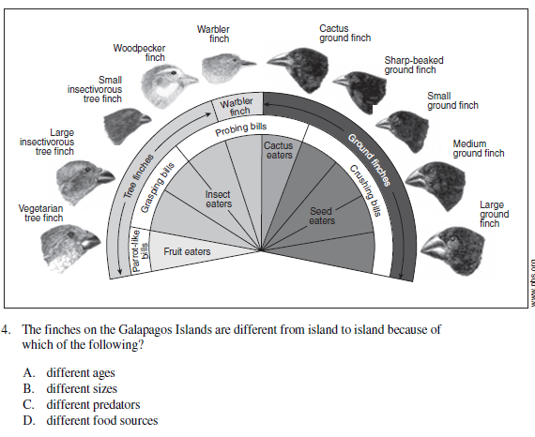
D – different beaks for different foods

Slide 34
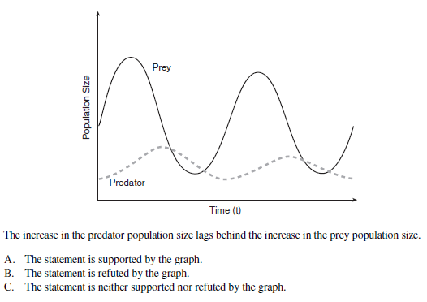
A - true

Slide 35
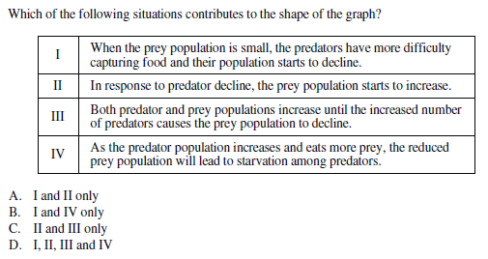
D – all are true

Slide 36
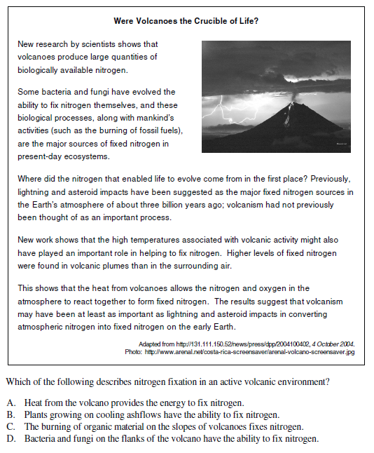
A

Slide 37
C – spreads human waste, pollutants

Slide 38
A – no natural predators

Slide 39
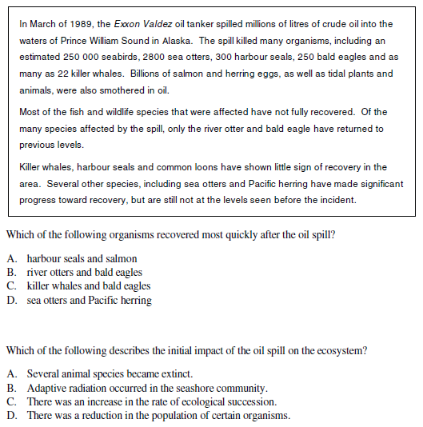
B
D

Slide 40
A – new species could outcompete native species

Slide 41
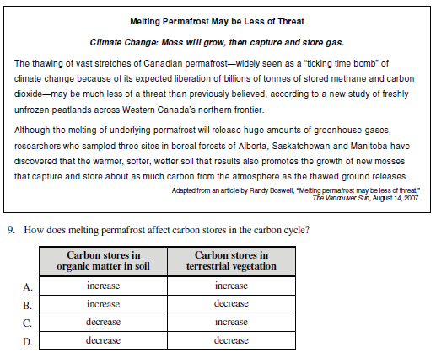
C – decrease, increase

Slide 42
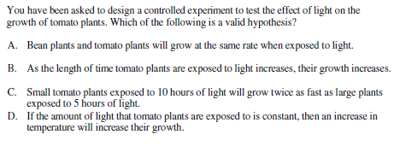
B – hypothesis is like a guess of what will happen

Slide 43
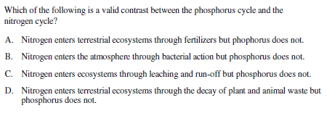
B – no phosphorus in the atmosphere

Slide 44
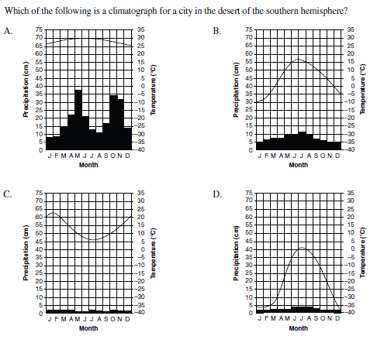
C – southern hemisphere has winter in July-August

Slide 45
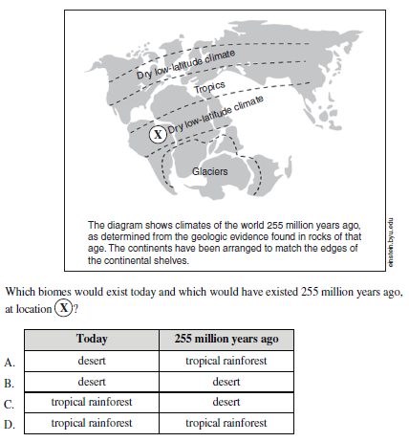
C – today these regions are tropical rainforests

Slide 46
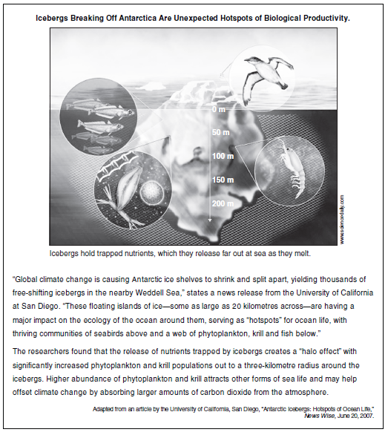
D

Slide 47
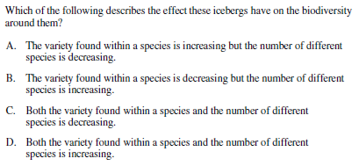
D – increasing biodiversity

Slide 48
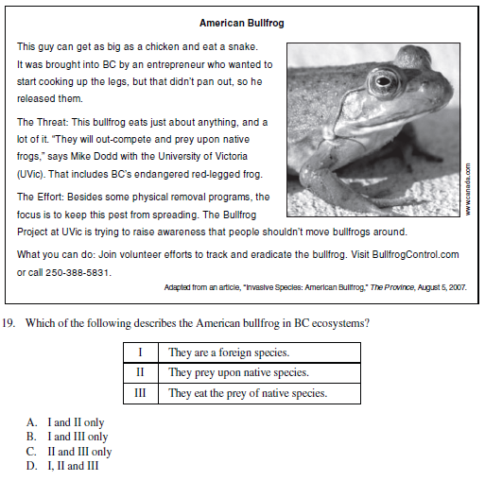
D – all are correct

