Slide 1
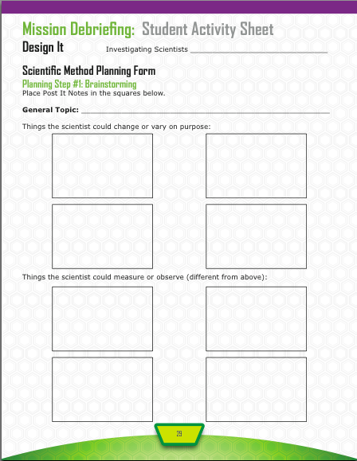
Exercise and the Body
Types of exercise
Quantity of exercise
Gender of exerciser
Intensity level of exercise
Heart rate
Respiratory rate
Blood pressure
Calories used

Slide 2
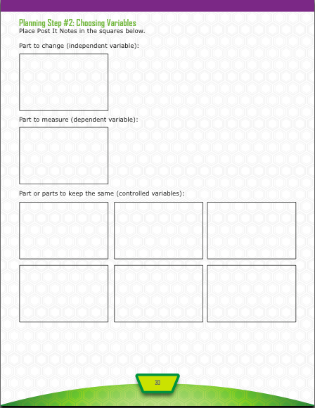
Quantity of exercise
Heart rate
Gender of exerciser
Type of exercise
Intensity level of exercise

Slide 3
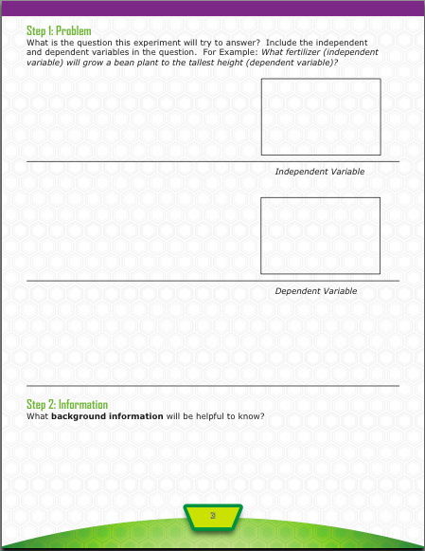
Quantity of exercise
How does
Heart rate
affect the
Heart
Muscles and oxygen use
stamina

Slide 4
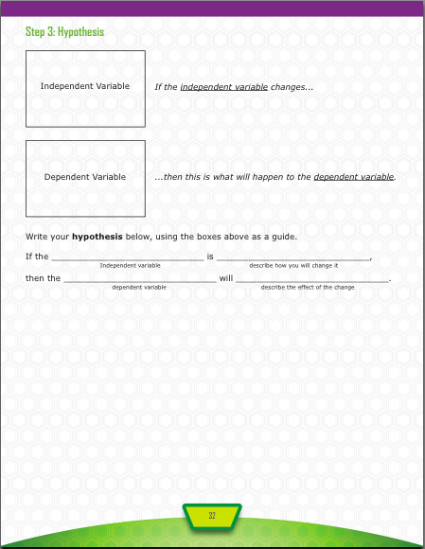
Quantity of exercise
Heart rate
quantity of jumping jacks
increased
heart rate
increase

Slide 5
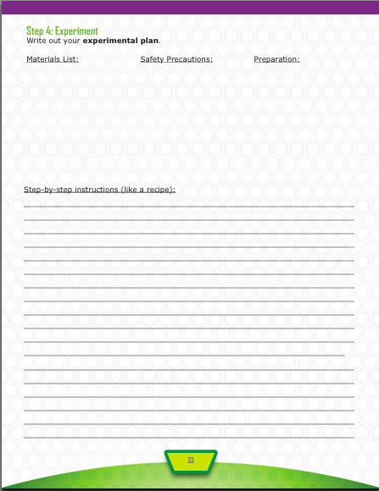
Take a resting heart rate.
Record data.
Do jumping jacks for 20 seconds. Take heart rate.
Record data.
Allow heart rate to return to the normal rate.
Do jumping jacks for 40 seconds at the same pace. Take heart rate.
Record data.
Allow heart rate to return to the normal rate.
Do jumping jacks for 60 seconds at the same pace. Take heart rate.
Record data.
Repeat steps 1-6 with three other people.

Slide 6
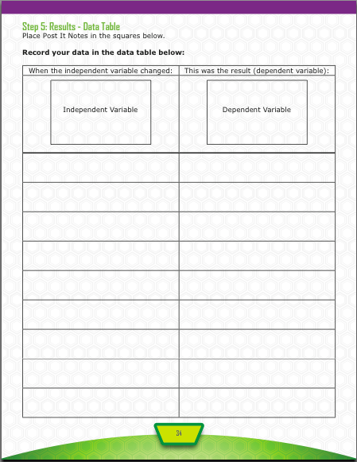
Quantity of exercise
Heart rate
Trial
1 2 3 4
Average
Total
0 seconds (resting)
20 seconds
40 seconds
_________________________
_________________________
60 seconds

Slide 7
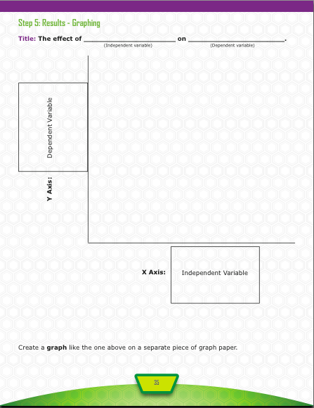
quantity of exercise
heart rate
Heart rate
Quantity of exercise

Slide 8
How does the quantity of exercise affect heart rate?
The data showed…..(don’t use personal pronouns like I and we)
For example, the heart rate for doing jumping jacks for 20 seconds averaged 85 beats per minute, while the heart rate for doing jumping jacks for 60 seconds was 95 beats per minute.
The hypothesis was (or was not) supported by the data.
Type of exercise
Respiratory rate

